Slide 1


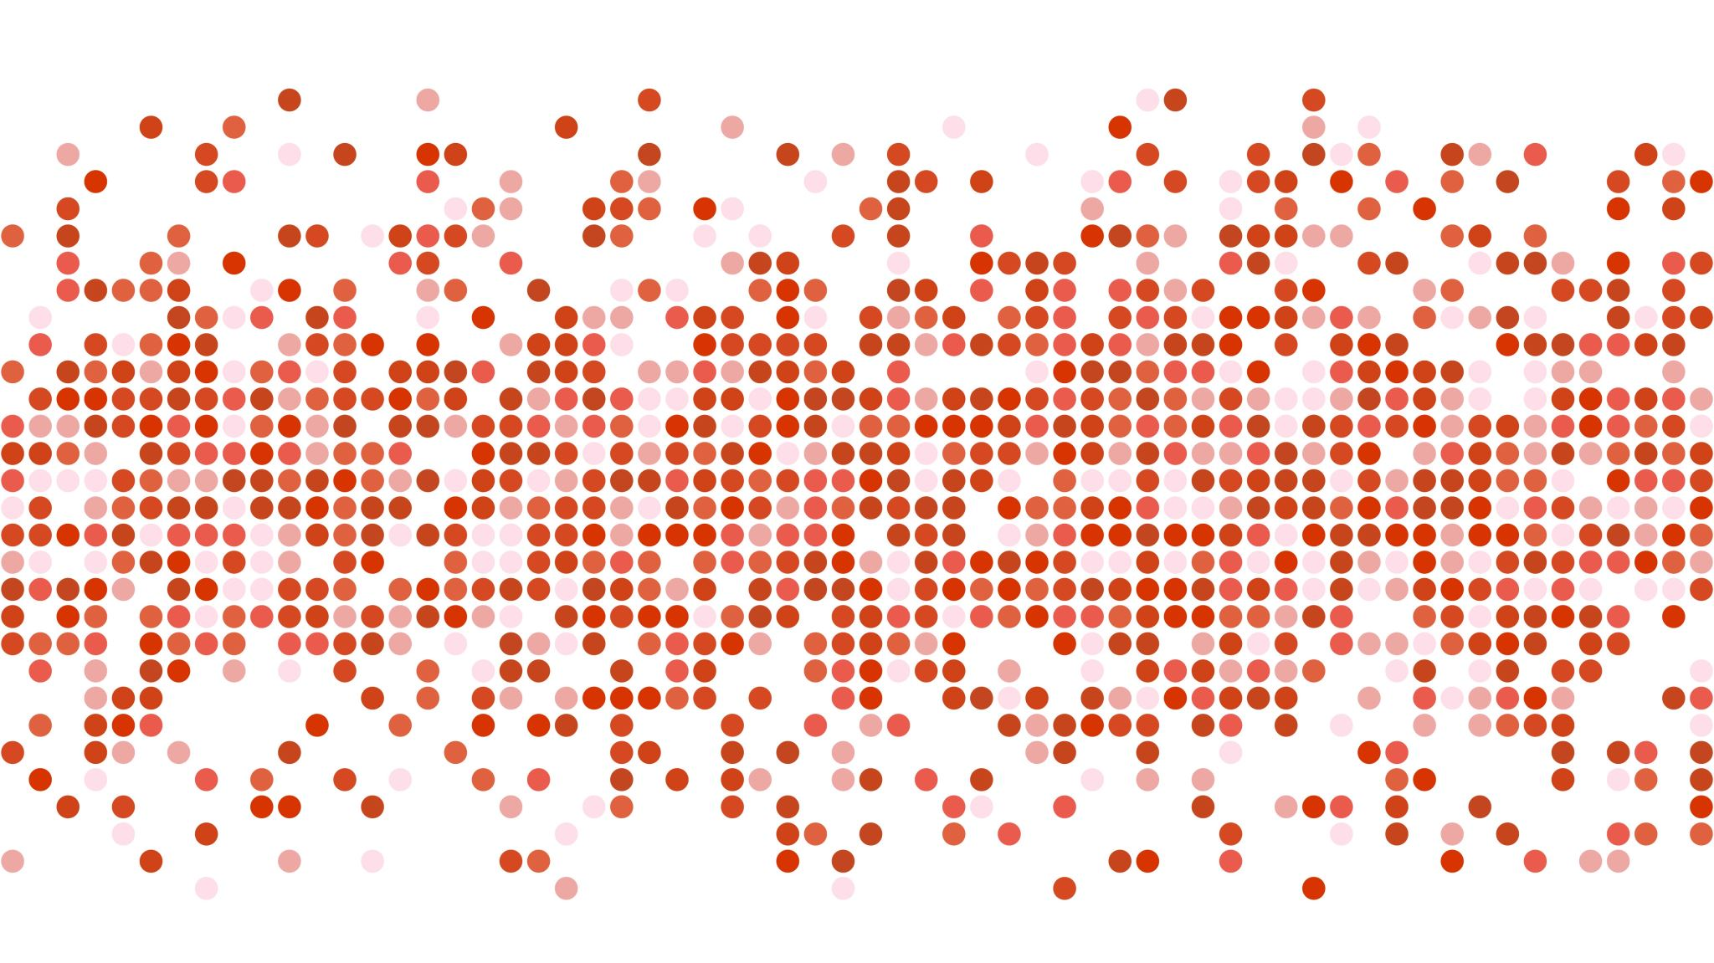
Customer and MARKET BASKET ANALYSIS FOR AN ONLINE RETAIL
Bhavya Sree BINDELA
A20448208

Slide 2
INTRODUCTION
Customer and Market Basket Analysis is to explore different types of customers
and their granular purchase behavior patterns using unsupervised learning techniques.
Customer segmentation is to uncover the behavior of the customers based on their interactions with the firm and divide them into groups, so that the company can target their customers efficiently for future customer retention strategies.
Market Basket Analysis is to uncover the product purchase behavior of customers by extracting the association rules of the products. These will be helpful to understand purchase decisions made by the customers and the firm can use the association rules in their future marketing strategies.

Slide 3

DATA SET
Dataset contains the Business data, and this data set belongs to a UK-based registered non-store online retail.
This Data set contains all the transactions data occurred between 01/12/2010 and 09/12/2011.
Number of Instances : 541909
Online Retail Dataset
Attribute | Description | Data Type
InvoiceNo | Invoice number | Character
StockCode | Product Code | Character
Description | Product Name | Character
Quantity | Quantity of each product per transaction | Number
InvoiceDate | Invoice Date and Time | Number
UnitPrice | Price of the Product per unit | Number
CustomerID | Customer Number | Number
Country | Country Name | Character

Slide 4

RESEARCH PROBLEMS
Identify the customers into different groups based on their behavior with the online retail.
Identify Top 10 Association rules for the products purchased in the online retail

Slide 5
PROPOSED SOLUTIONS
Identify the customers into different groups based on their behavior with the online retail.
RFM Analysis is the data-driven customer segmentation technique.
Recency : Number of days from the last purchase
Frequency : Number of visits
Monetary : Total amount spent
we use both K-means Clustering and Hierarchal clustering algorithms on RFM data for customer segmentation.
Identify Top 10 Association rules for the products purchased in the online retail.
Perform Market Basket Analysis to find association rules for products.
Group the products based on InvoiceNo and apply Apriori association rule mining algorithm to find the association rules for the products.

Slide 6
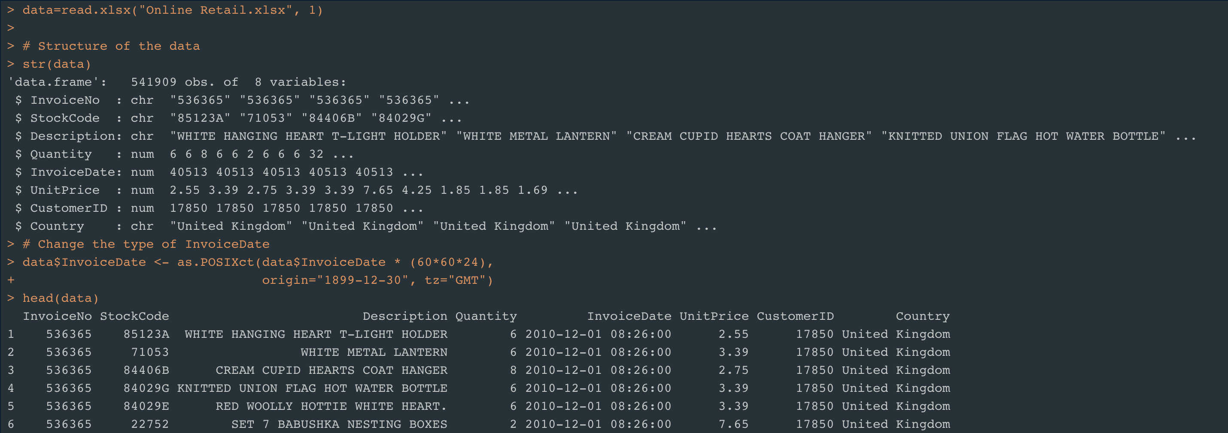
Load the Data

Slide 7
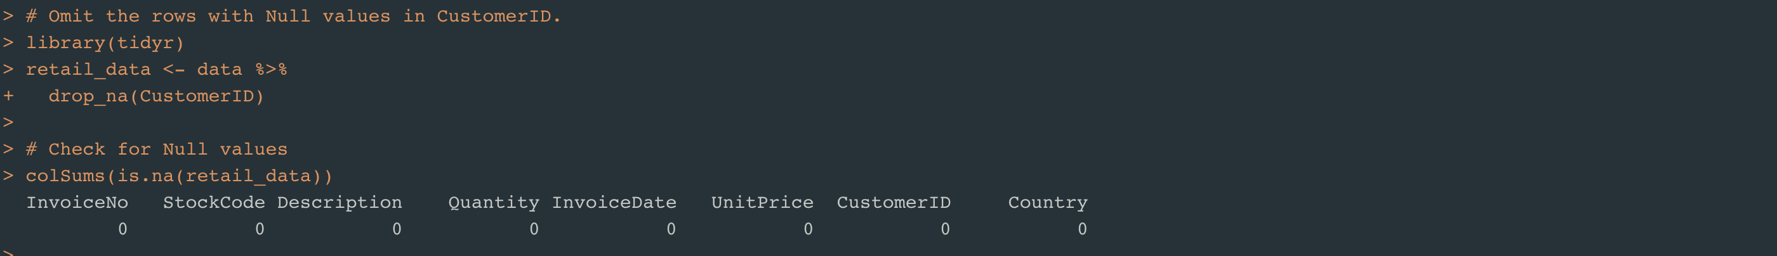
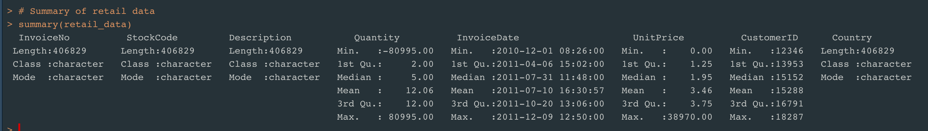
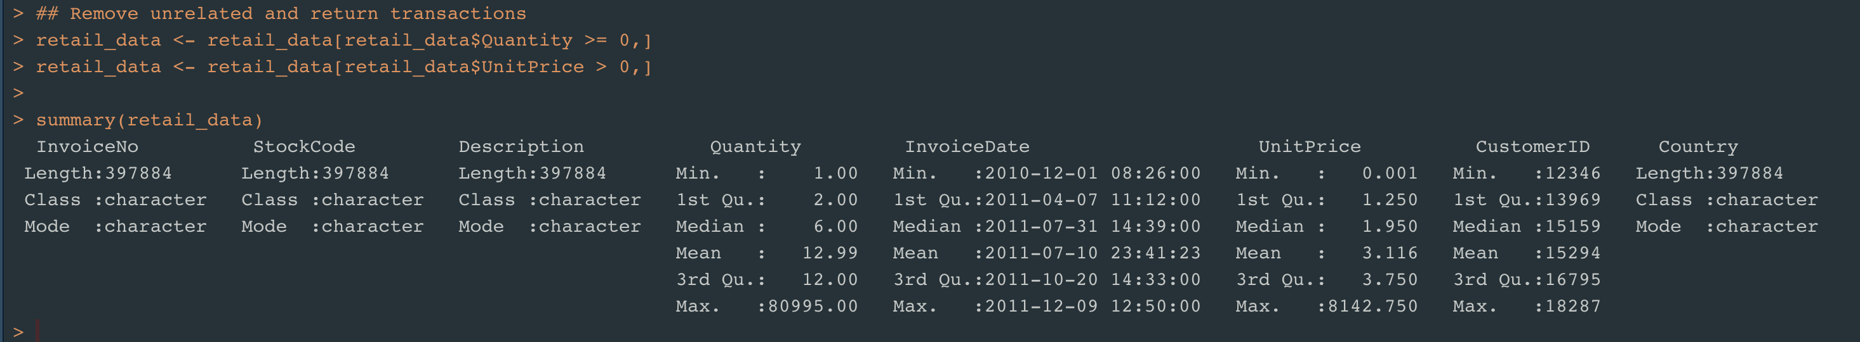
Pre-Processing the Data
Remove return Transactions - Summary of data

Slide 8
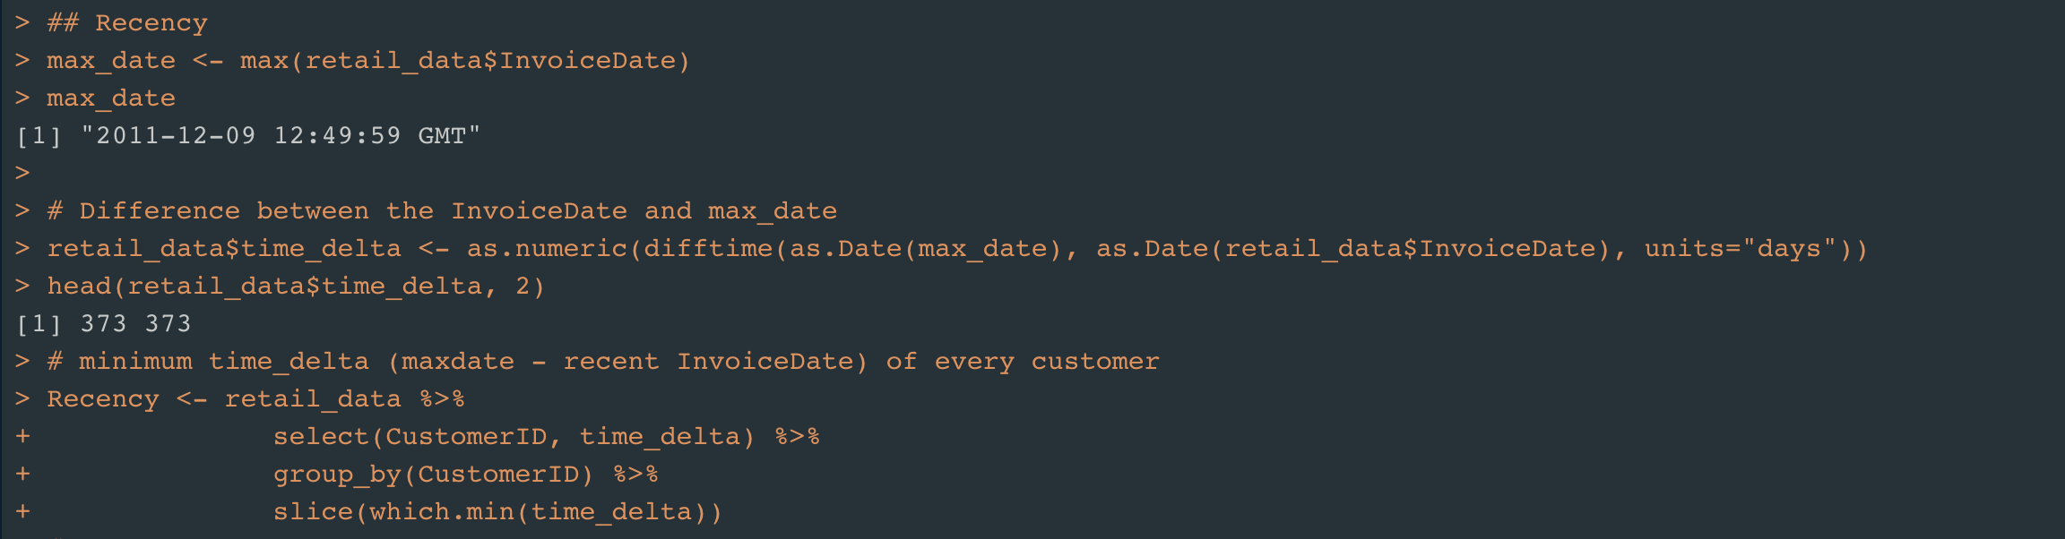
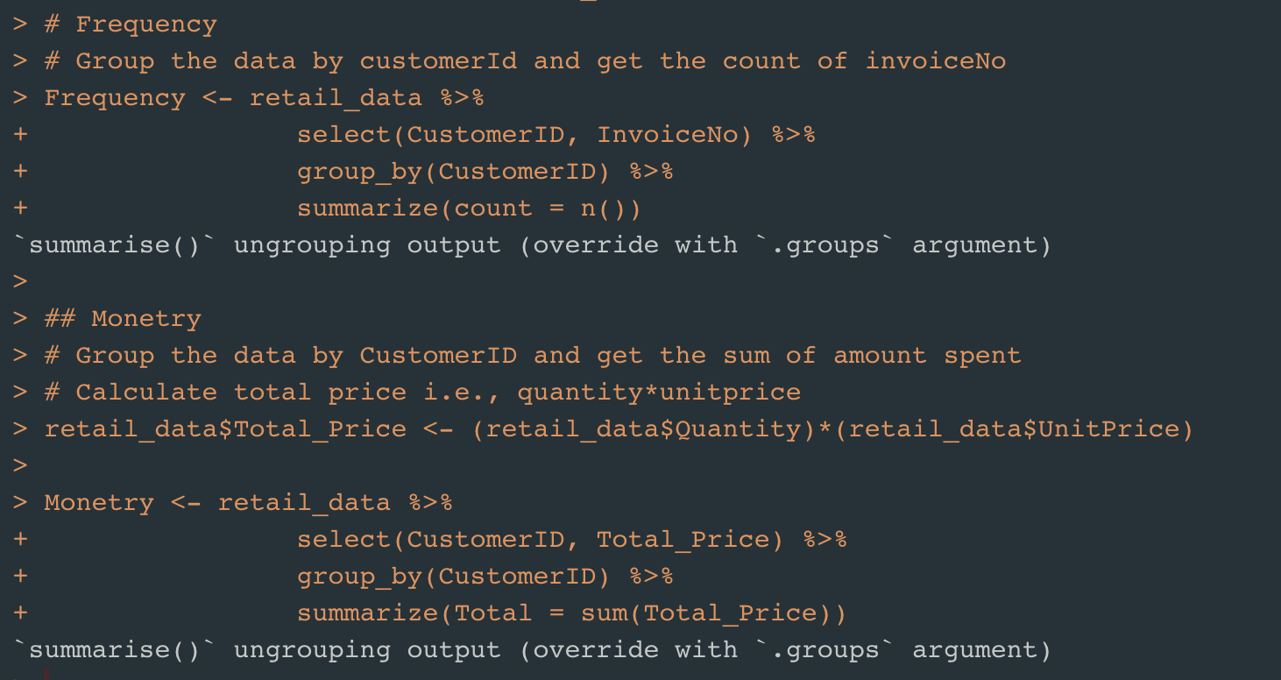
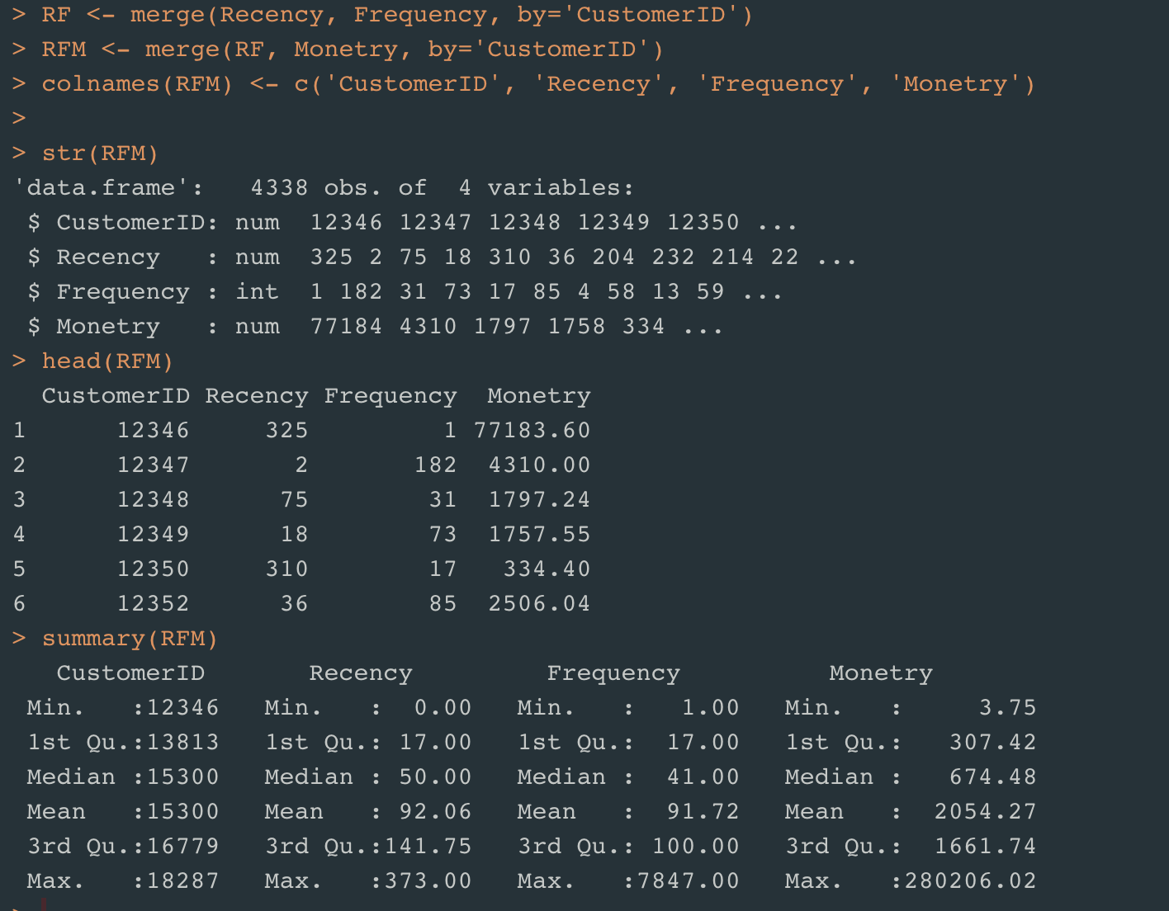
Customer Segmentation – Calculate RFM

Slide 9
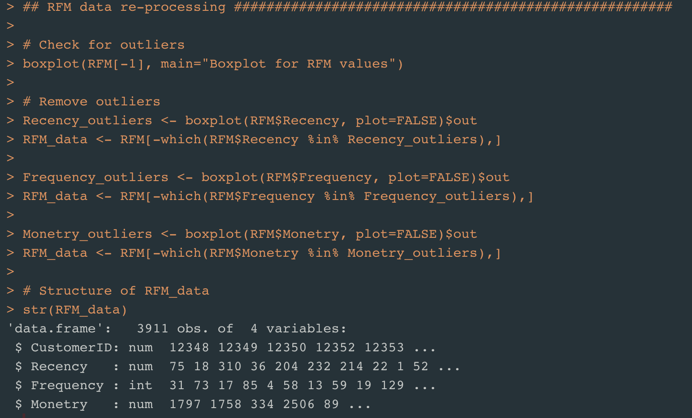
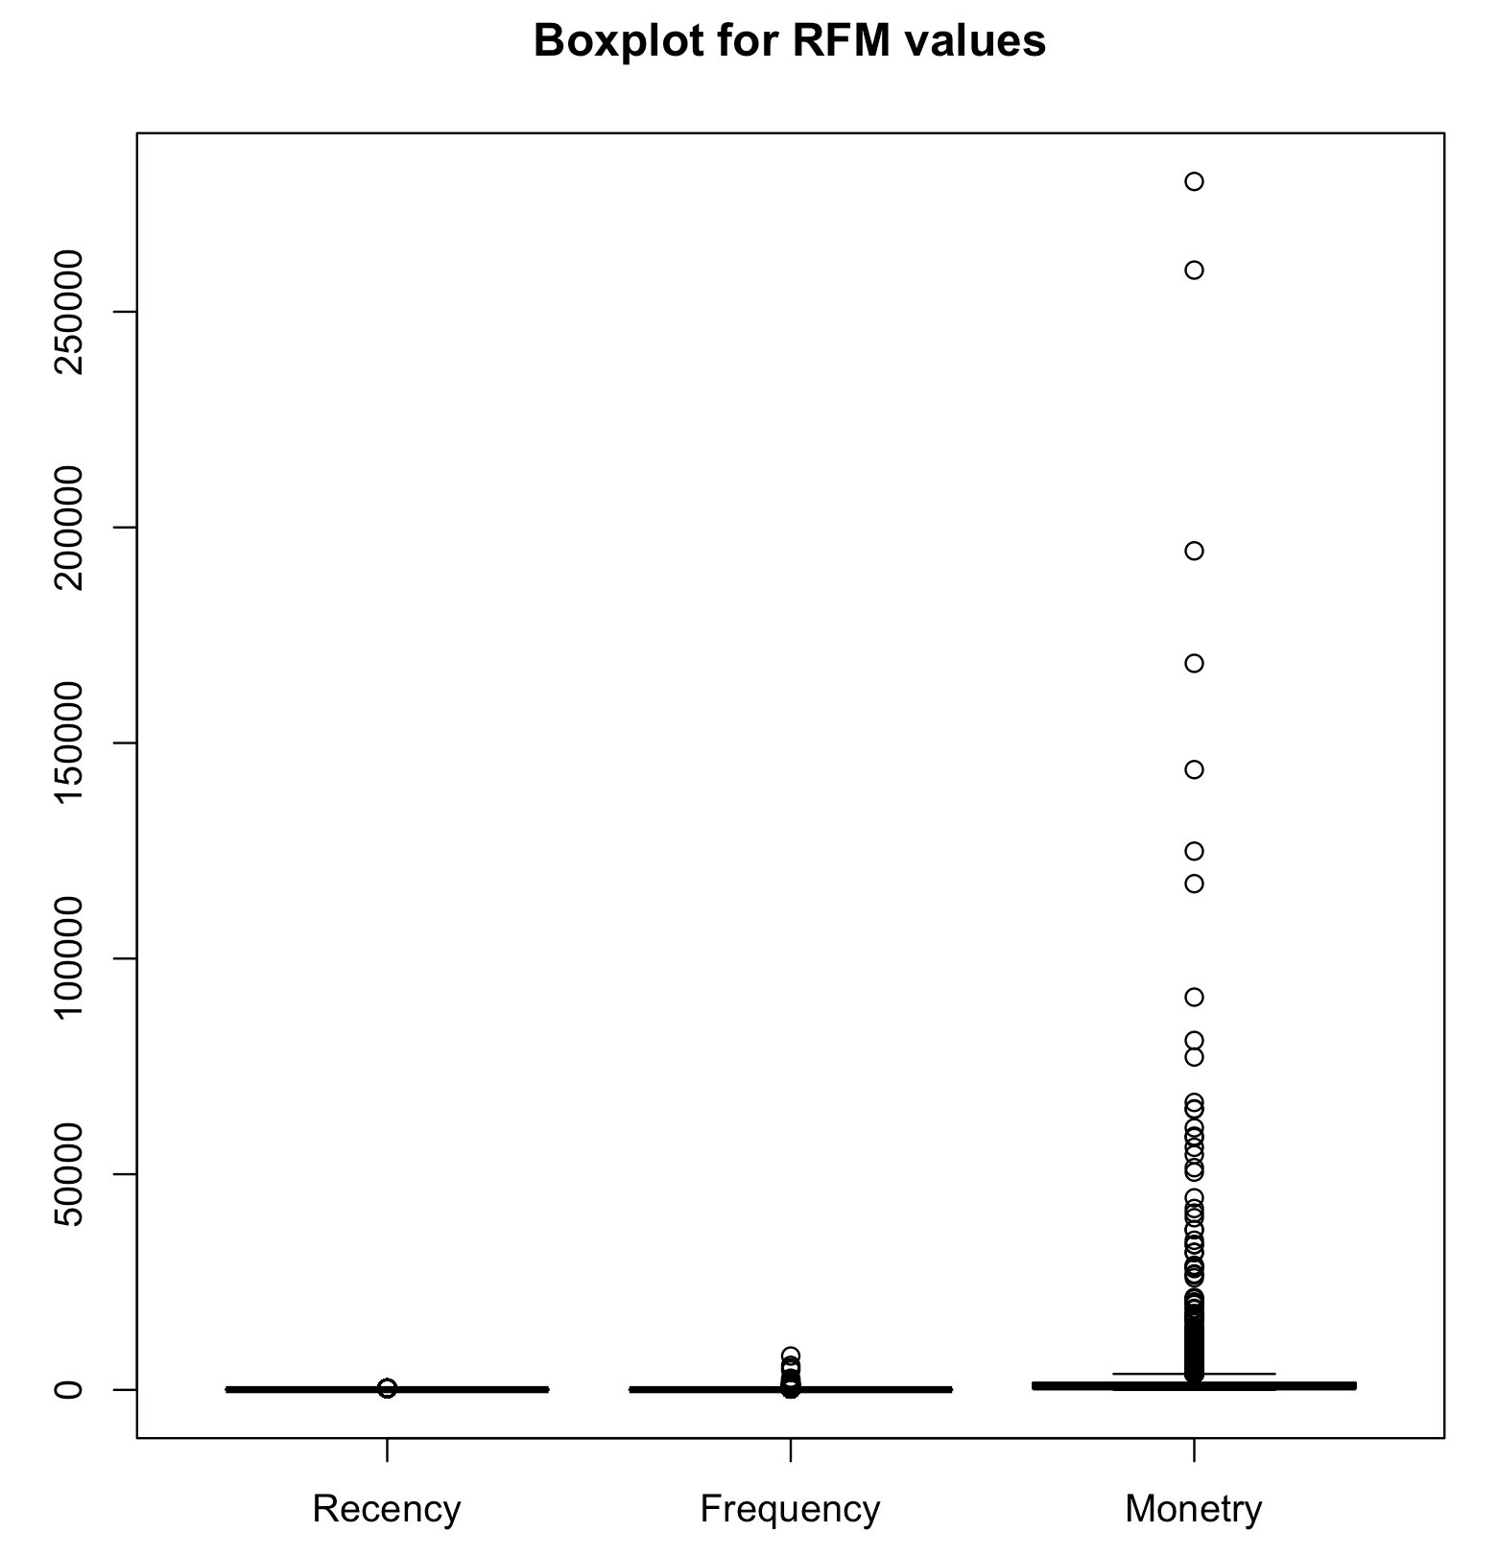
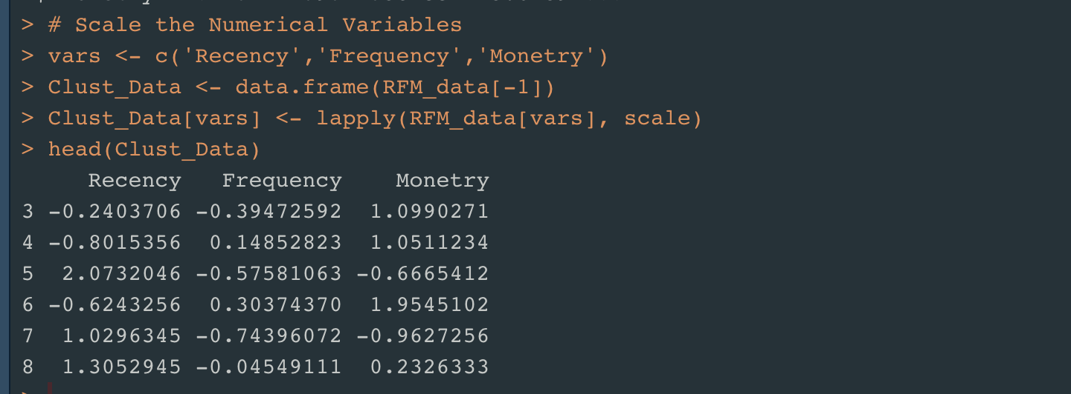
RFM data Pre-Processing

Slide 10
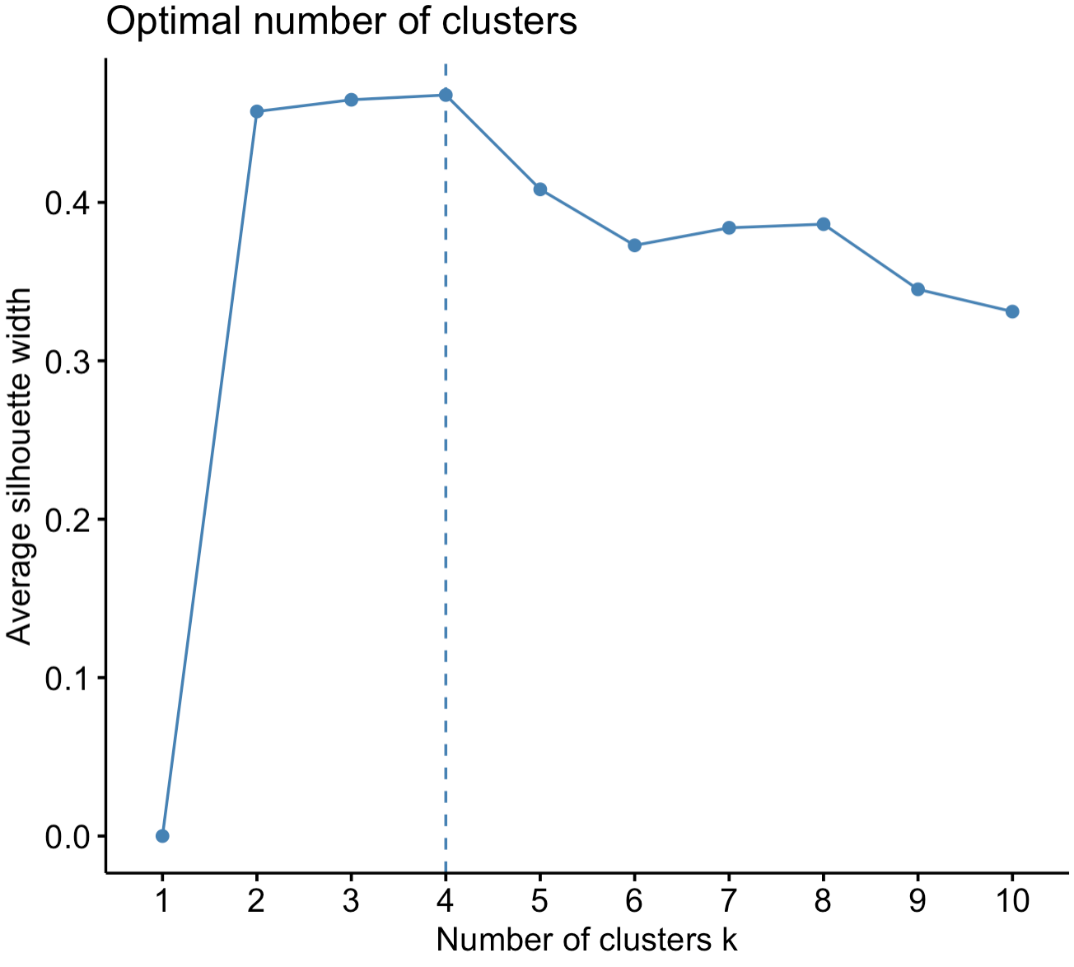
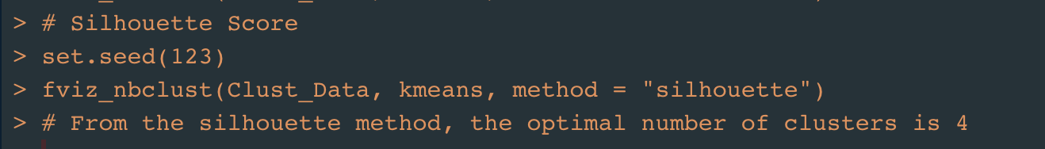
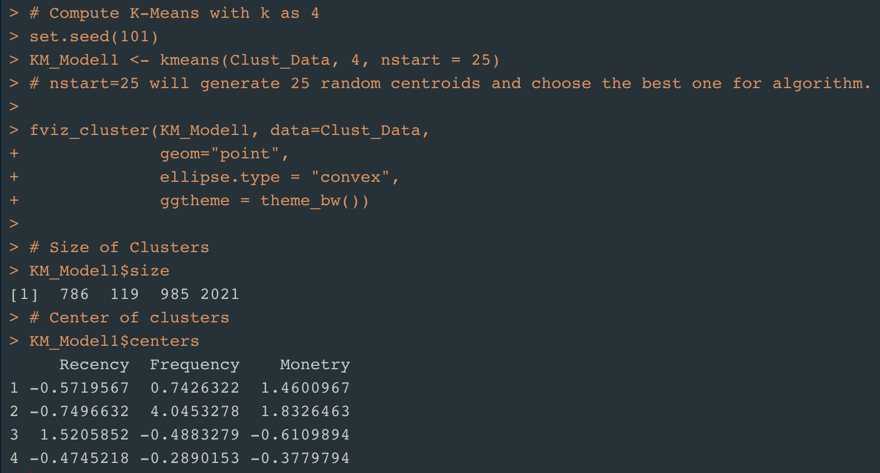
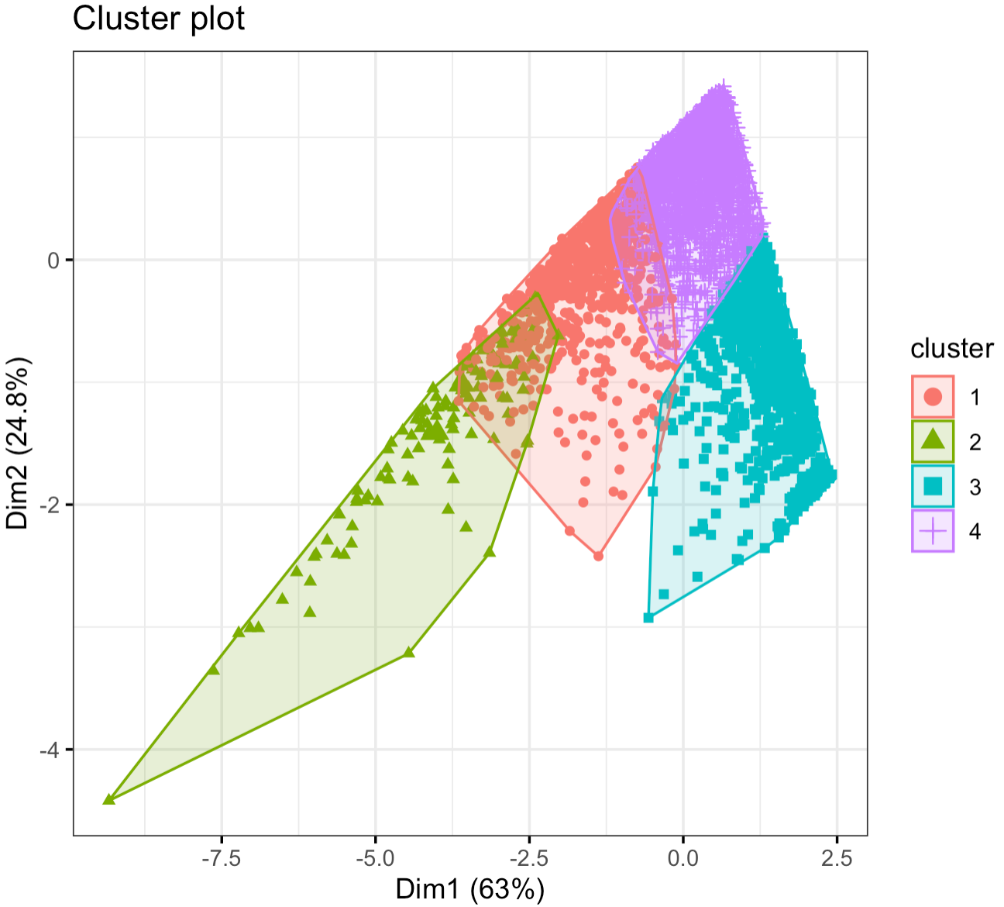
K-Means Clustering
Silhouette Method
Silhouette Score is a measure of how similar an object is to its own cluster. Ranges from -1 to +1

Slide 11
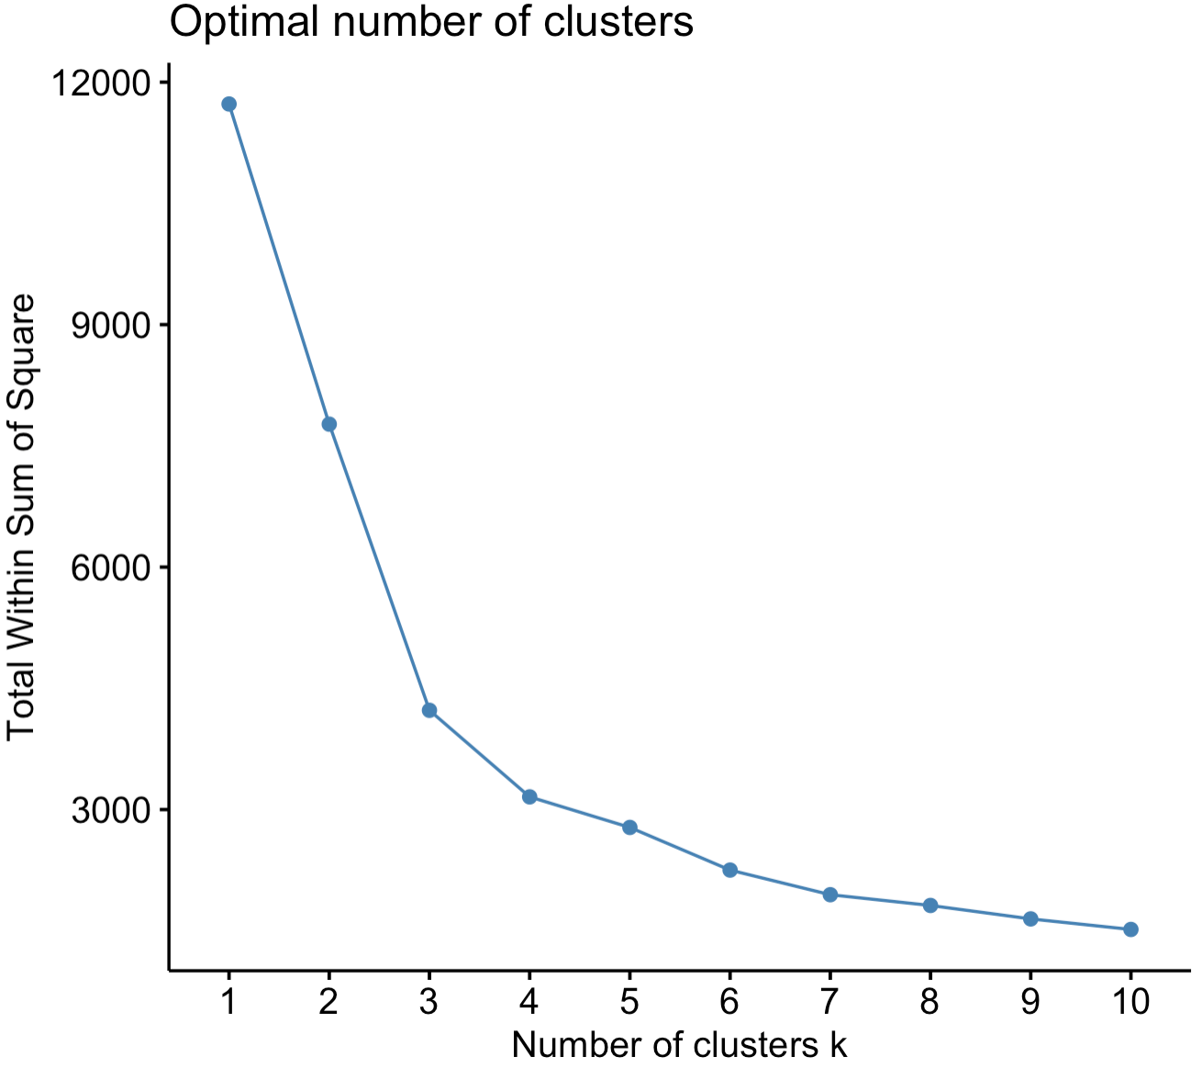
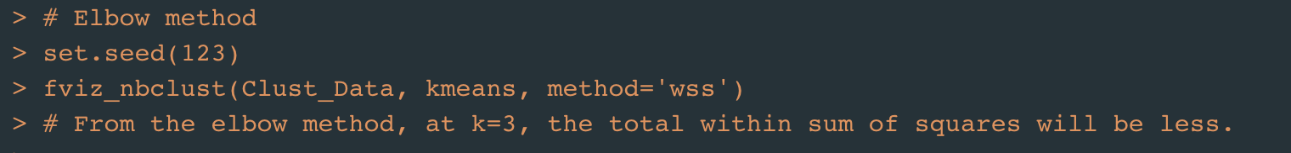
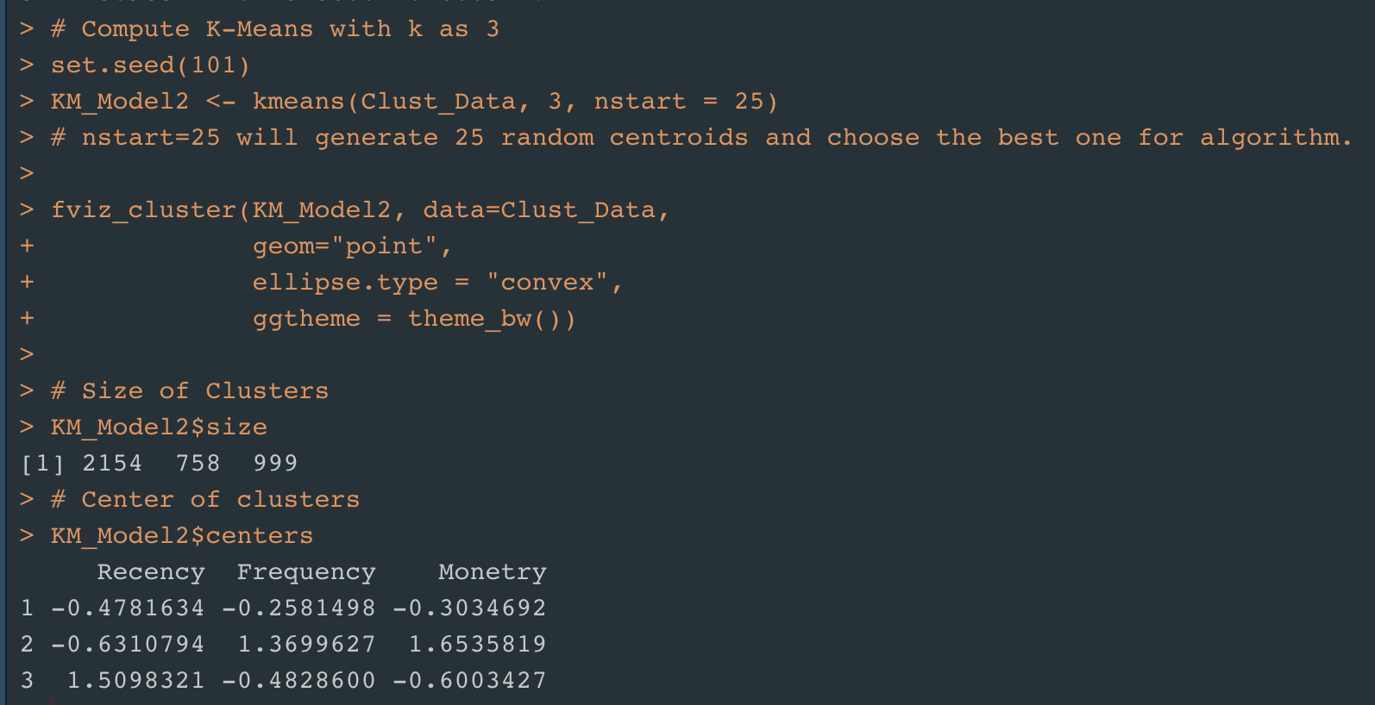
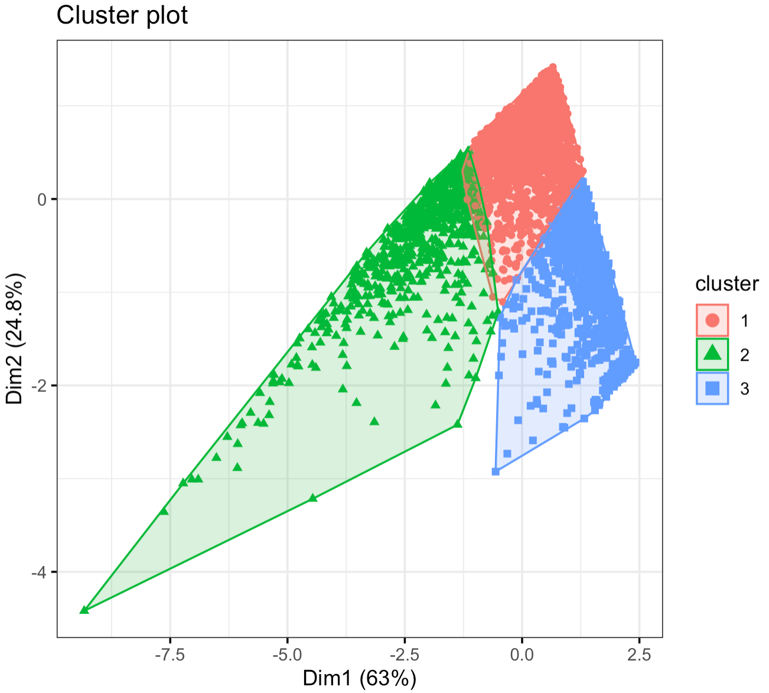
K-Means Clustering
Elbow Method
Elbow Method gives the total Within Sum of Squared Errors for different values of K.

Slide 12
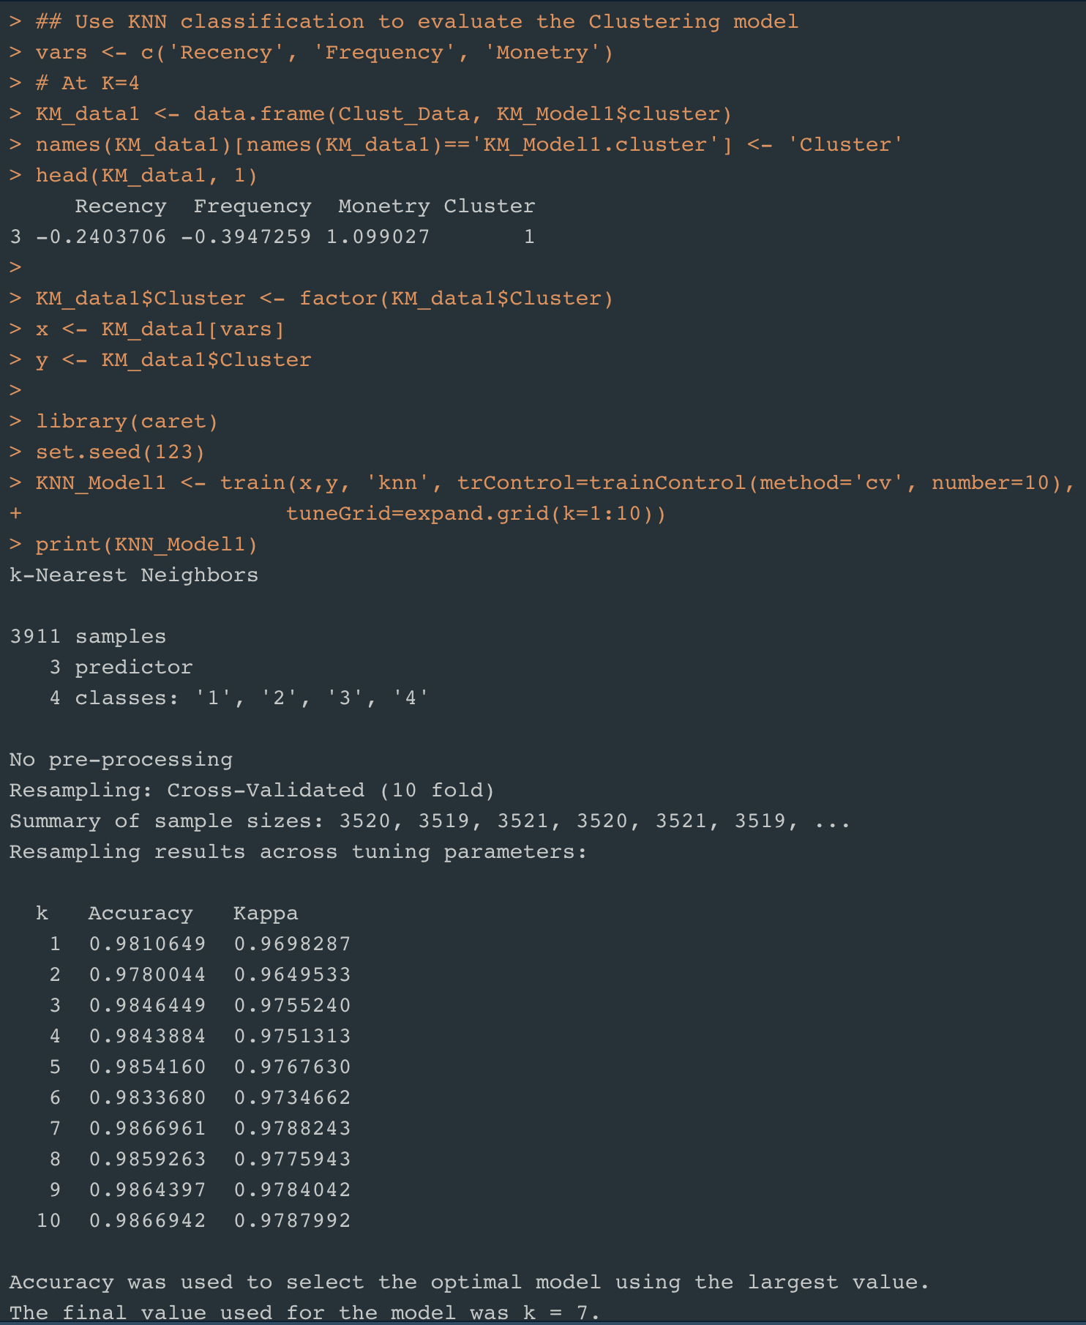
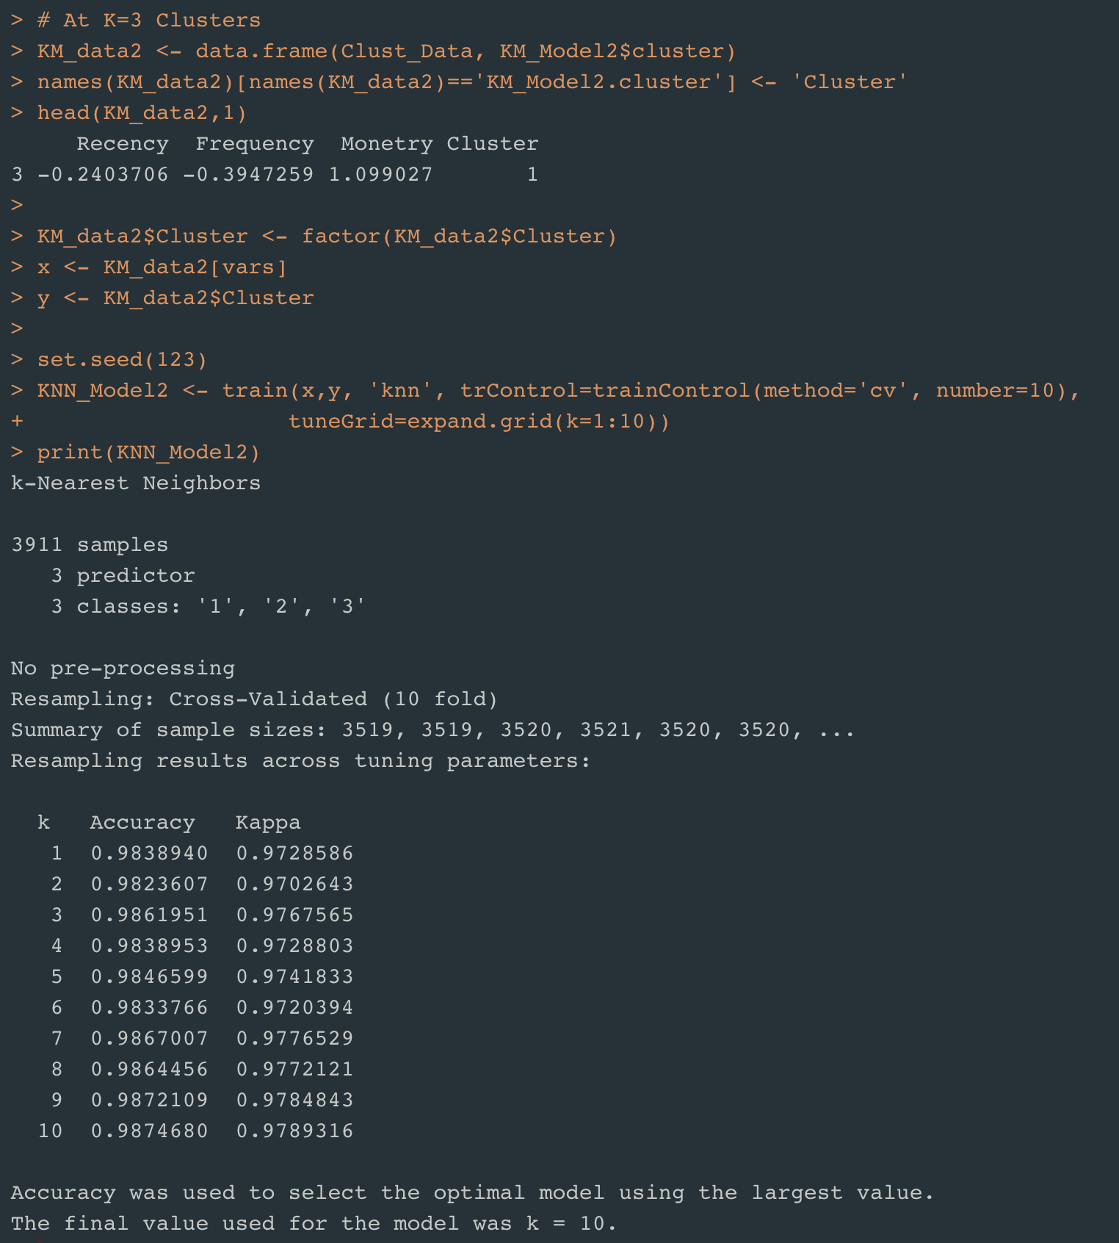
K-Means Clustering - Evaluation
Sample: 3911
N-Fold Cross Validation at N= 10

Slide 13
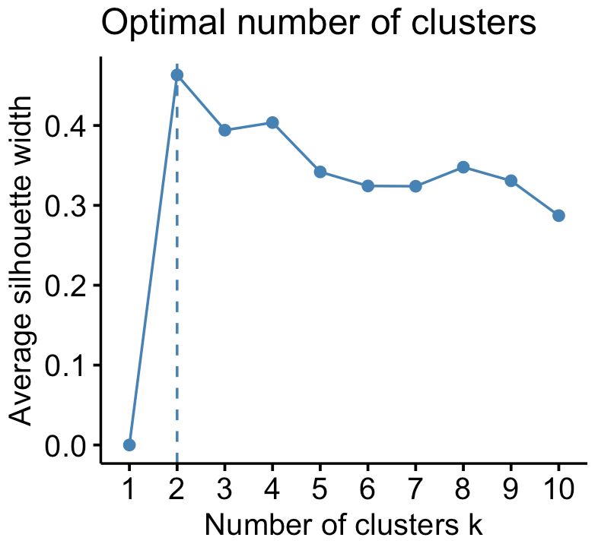
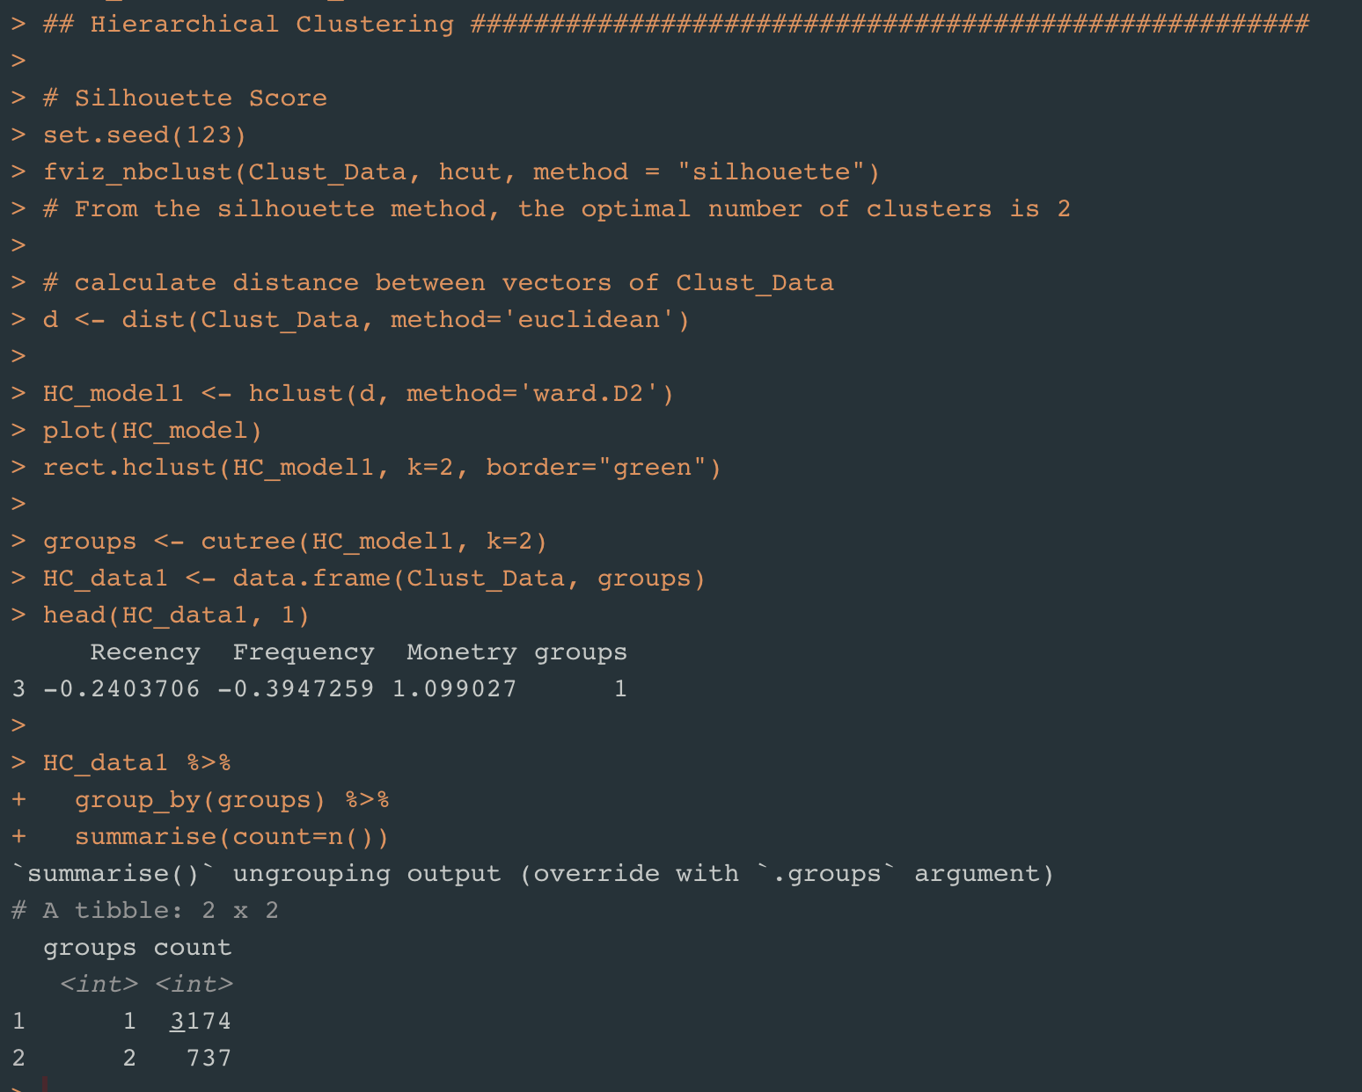
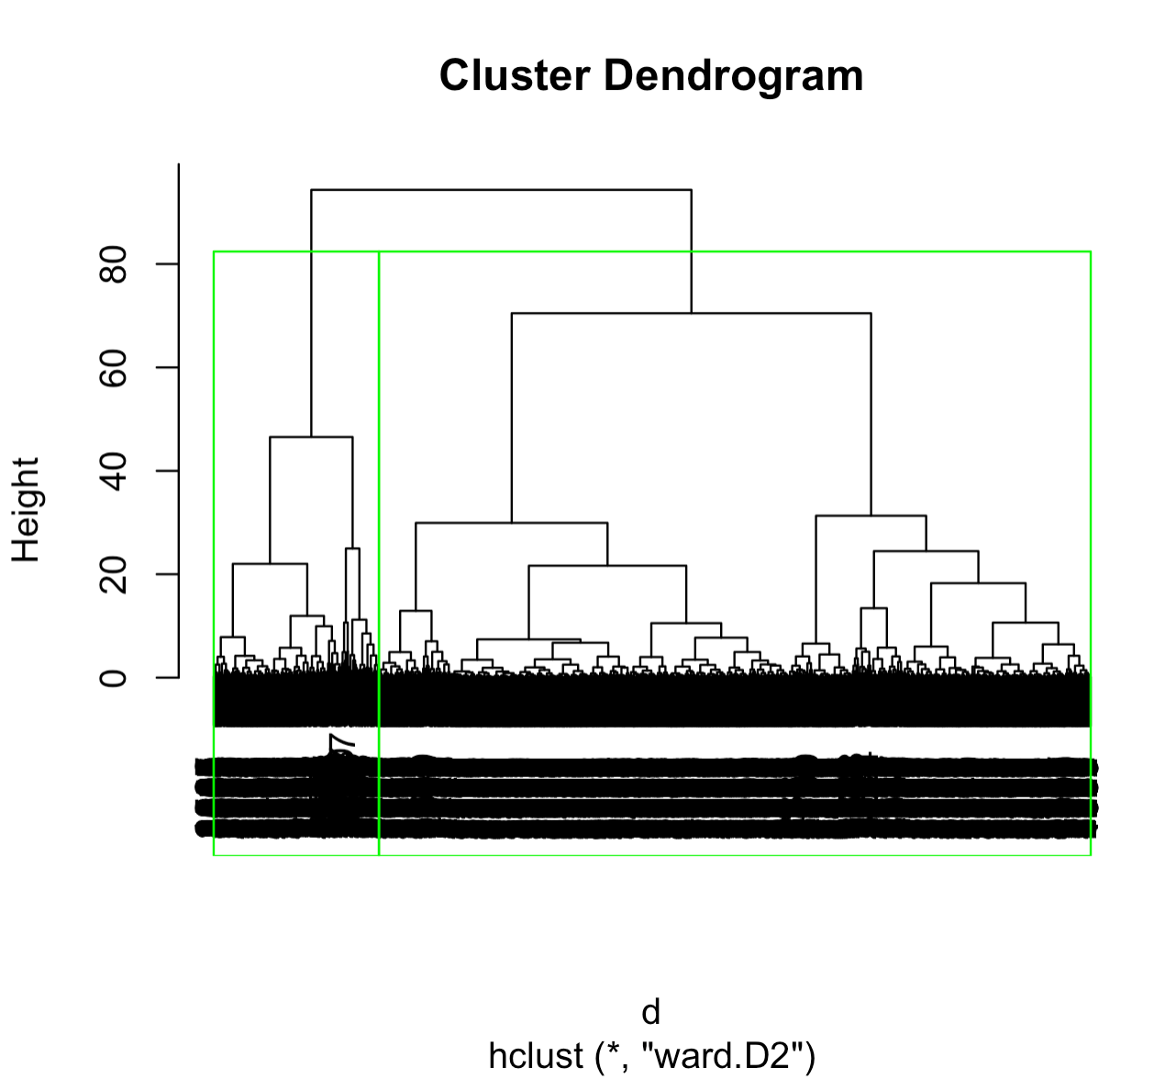
Hierarchical Clustering – K with Silhouette Method

Slide 14
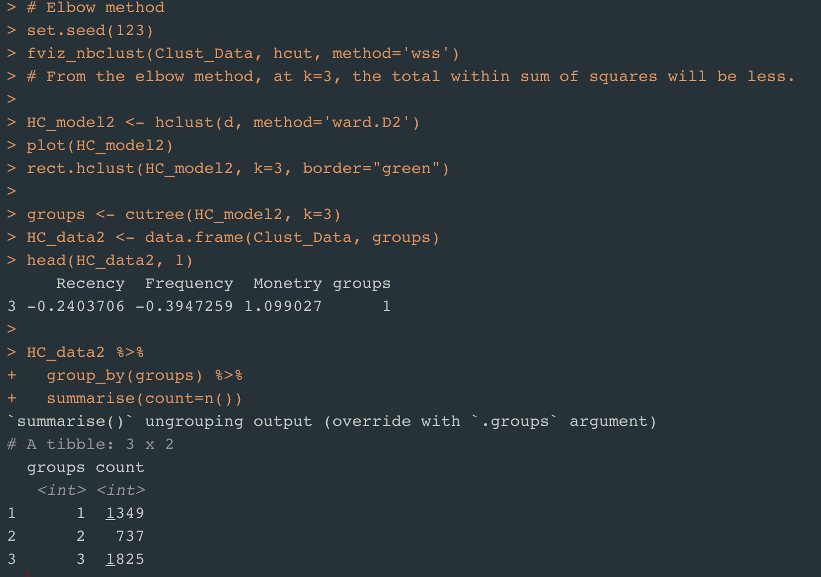
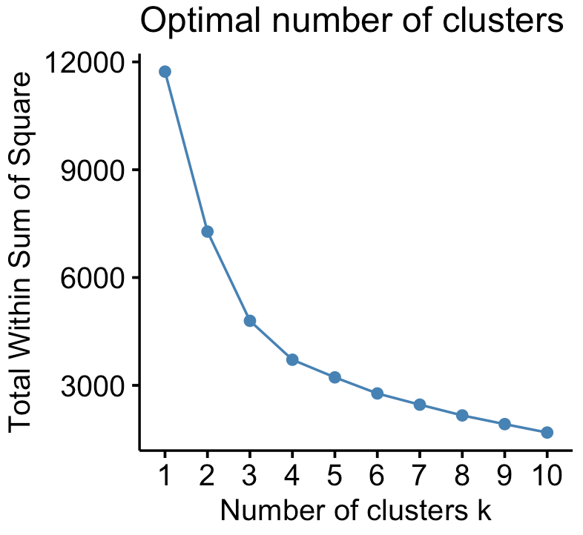
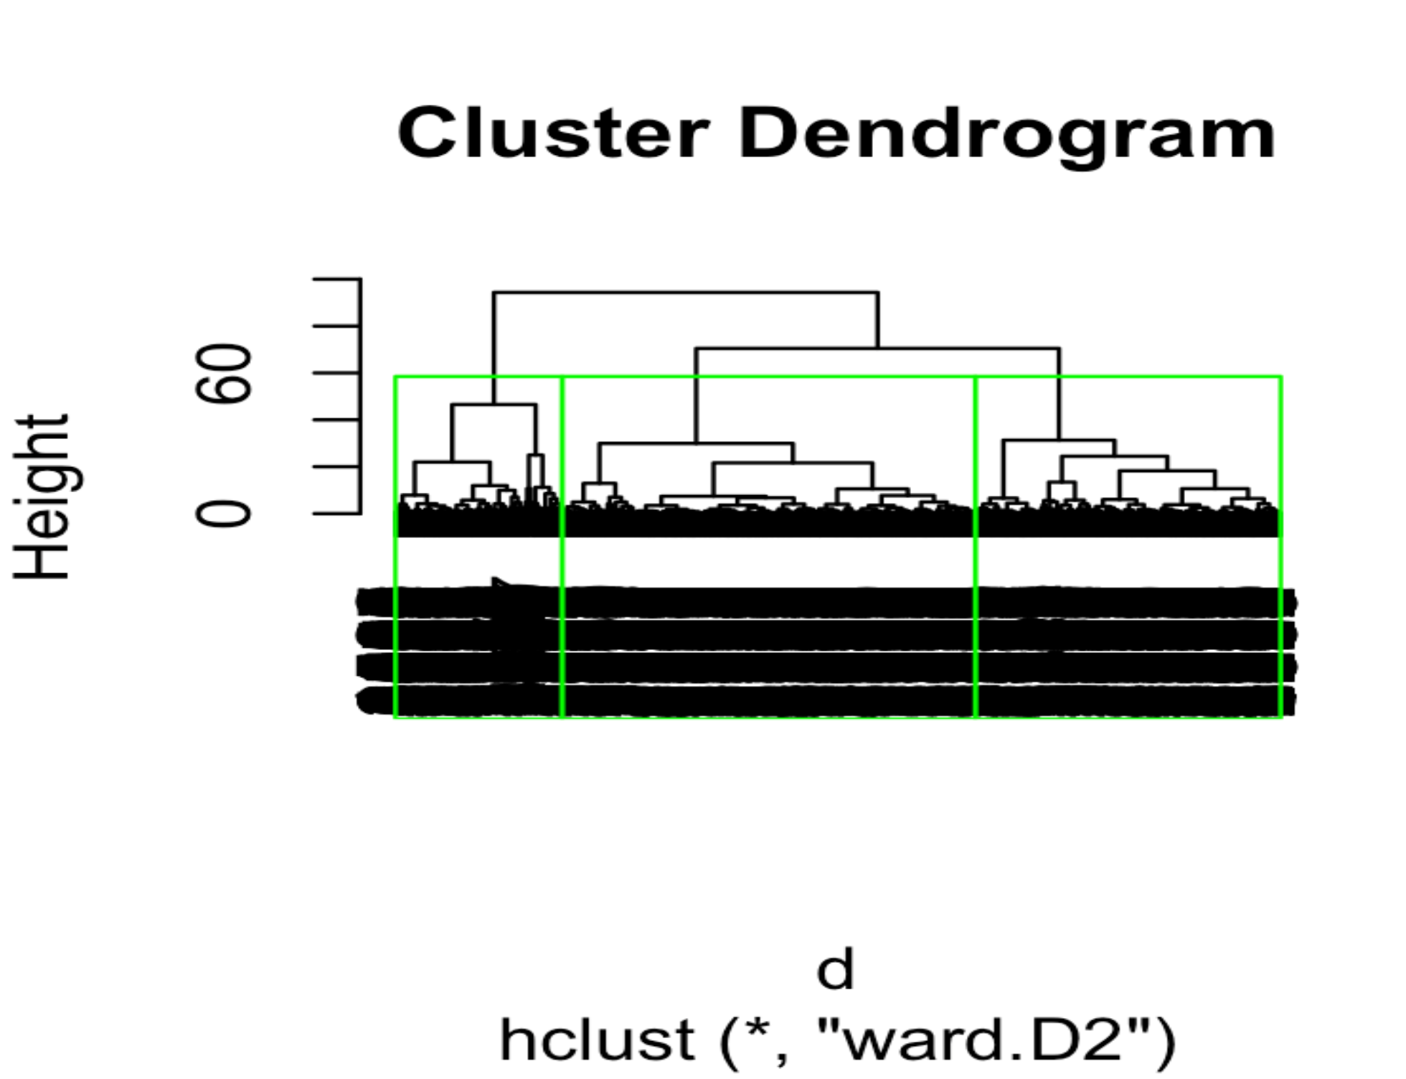
Hierarchical Clustering - K with Elbow method

Slide 15
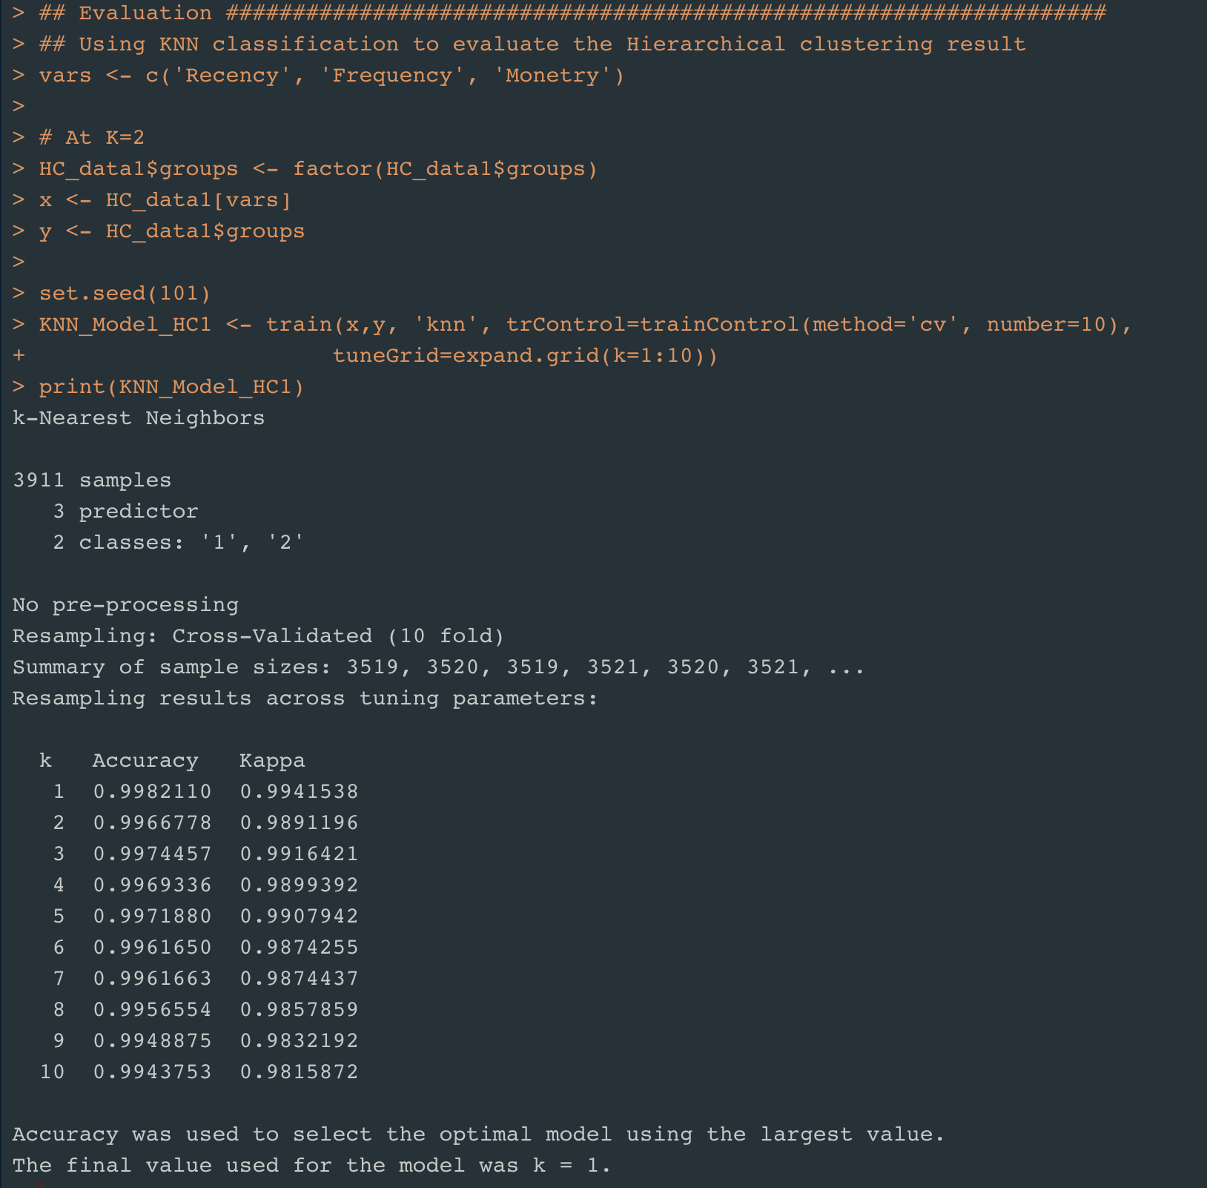
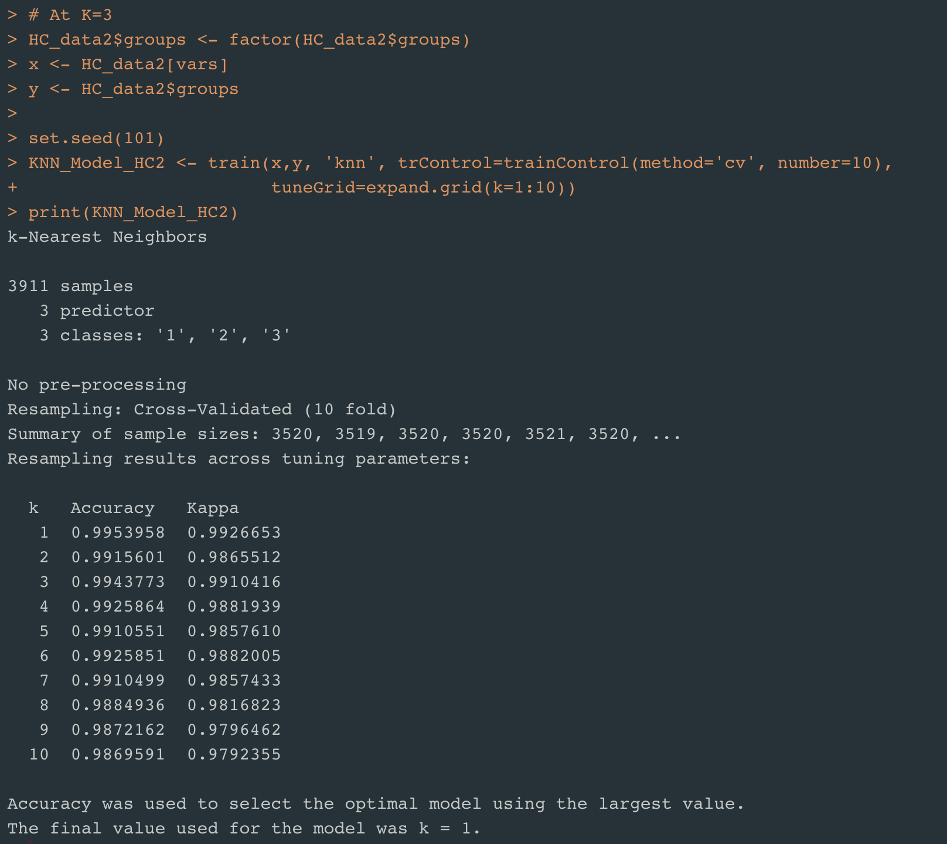
Hierarchical Clustering - Evaluation
Sample: 3911
N-Fold Cross Validation at N= 10

Slide 16
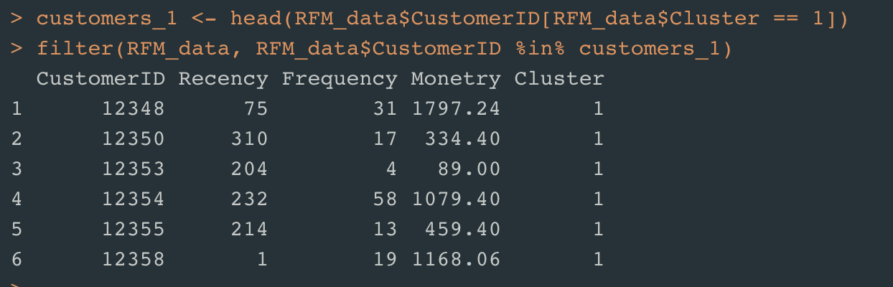
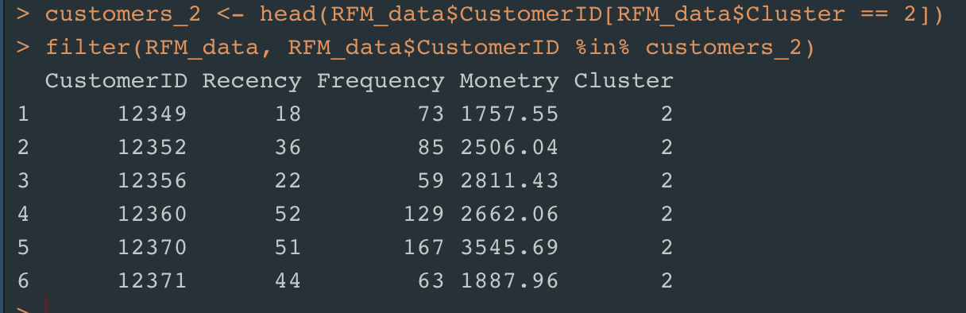
Customer Segmentation- Conclusion
Accuracy
K-Means Clustering |  | Hierarchical Clustering
K = 4 | K =3 | K = 2 | K = 3
0.986 | 0.987 | 0.998 | 0.995
Cluster 1 is of the customers who are neither Recent, Frequent or spent more amount in the online Retail.
Cluster 2 is of the customers who are Recent, Frequent and spent more amount in the online Retail.
Customers in Cluster 2 are Best Customers.

Slide 17
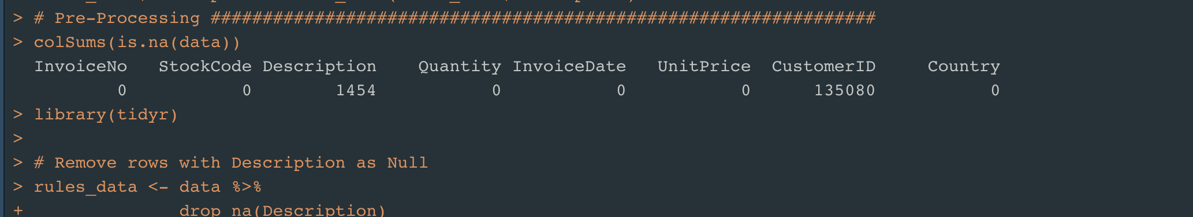
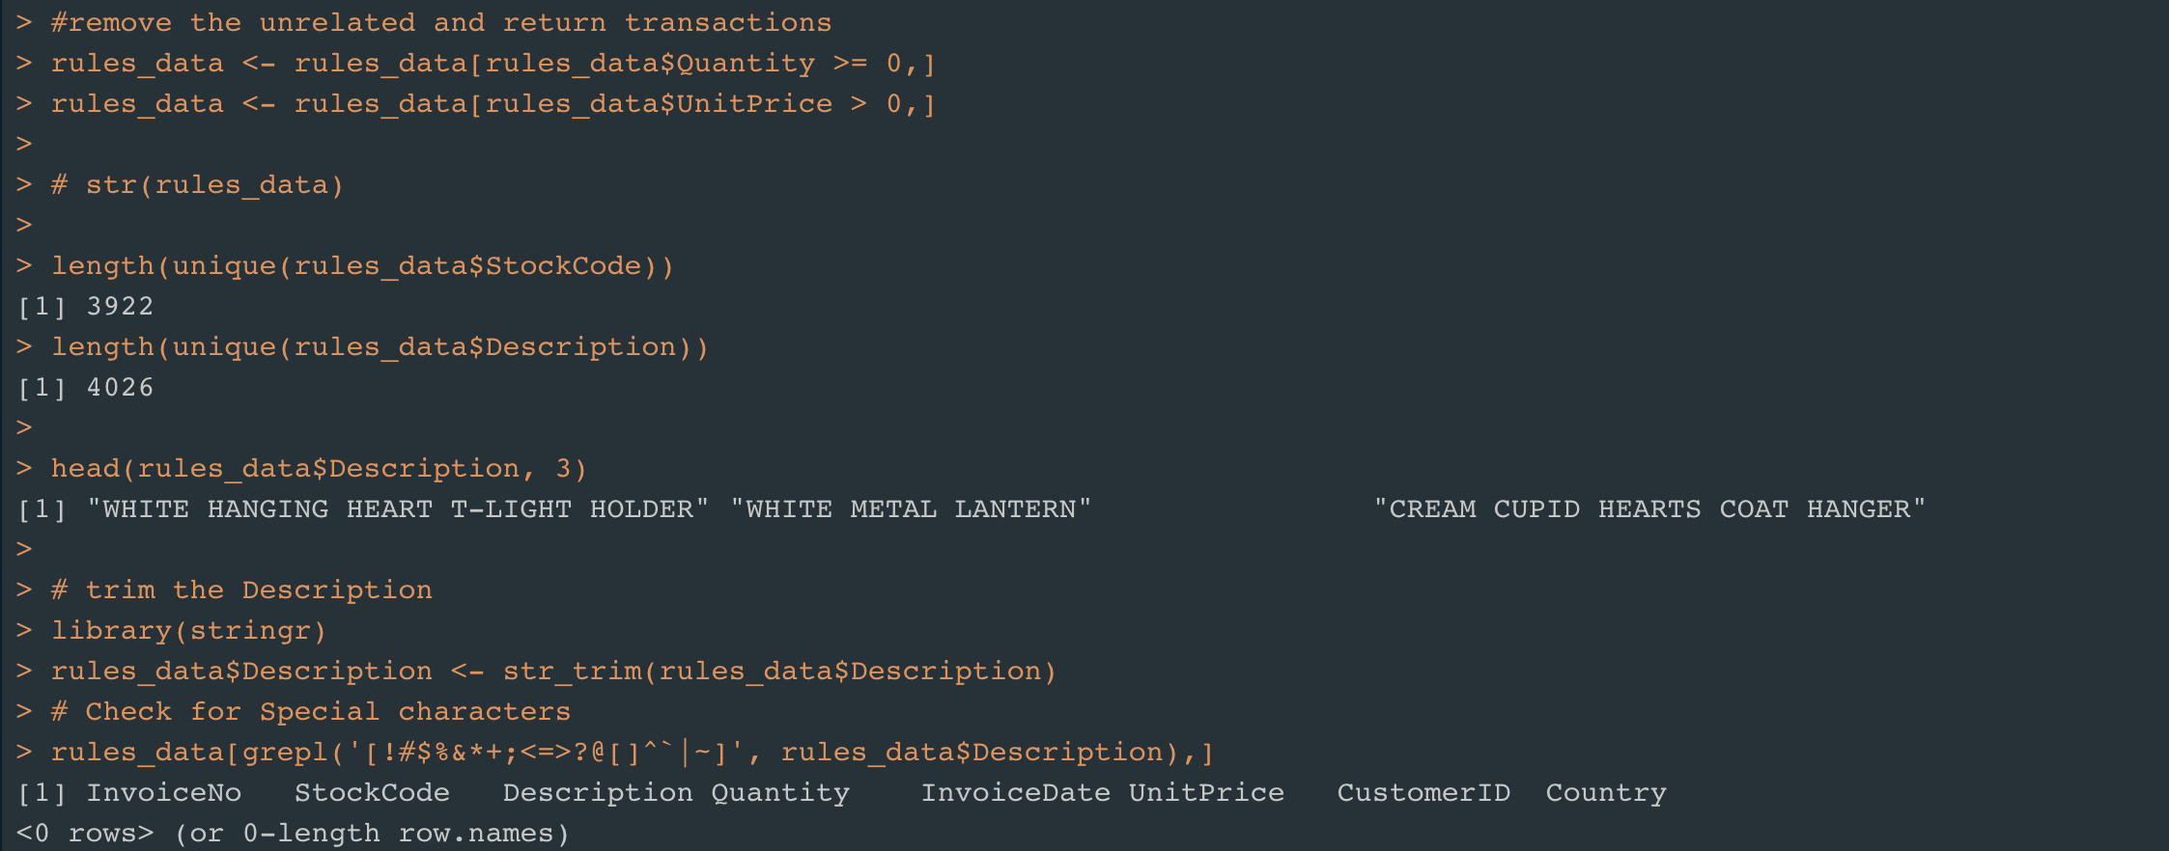
Market Basket Analysis – Association rules
Pre-Processing the data

Slide 18
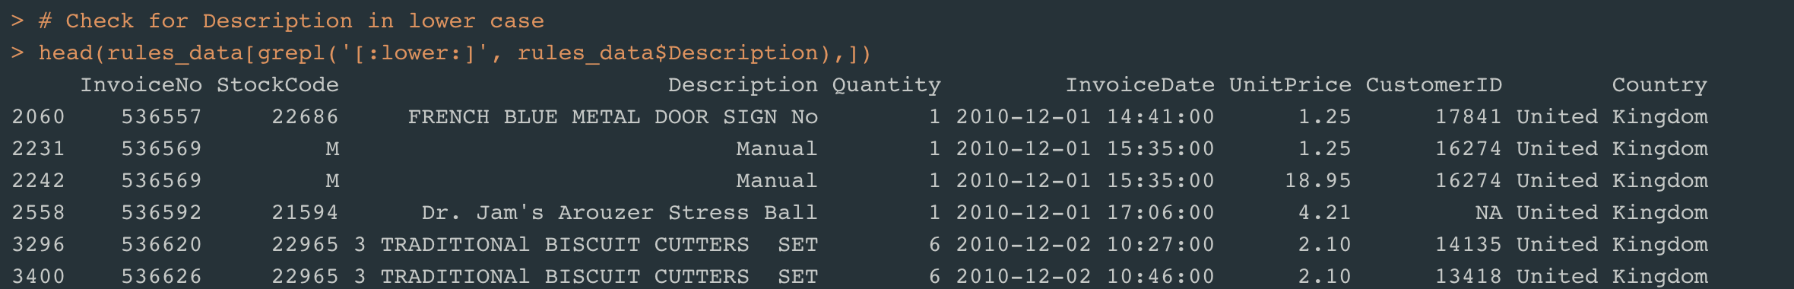
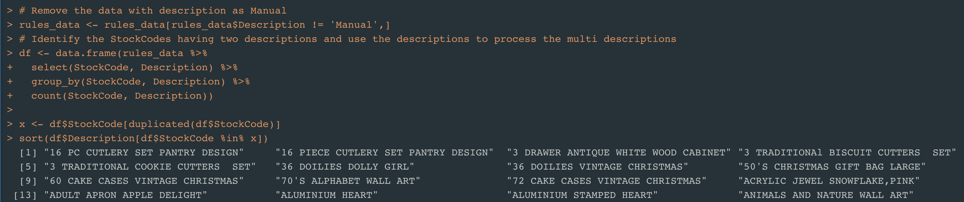
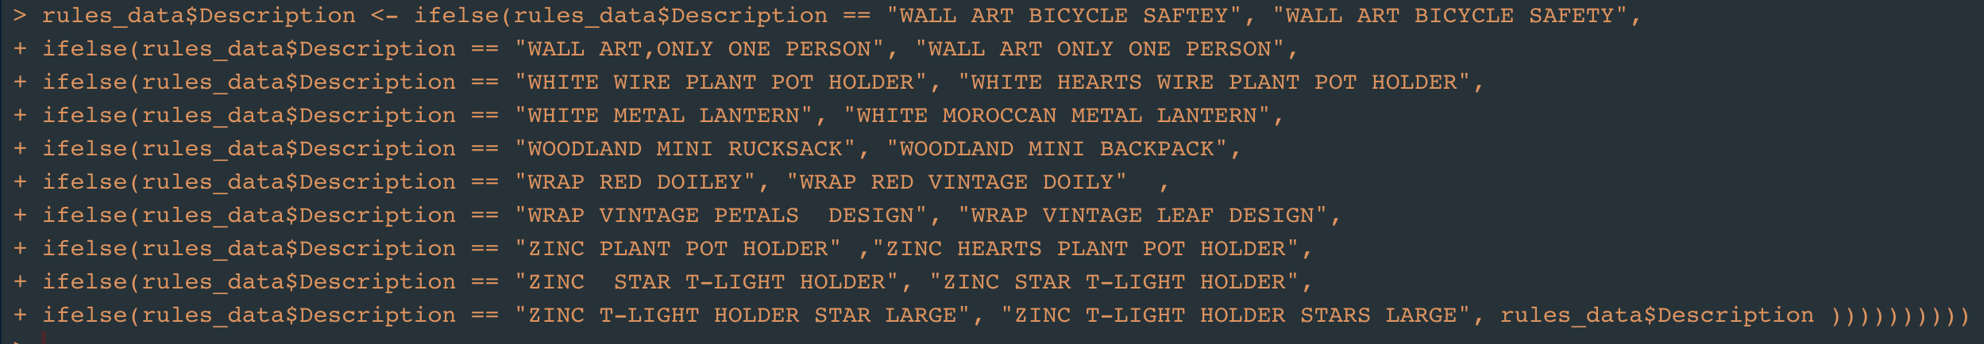
Market Basket Analysis – Pre-Processing the data

Slide 19
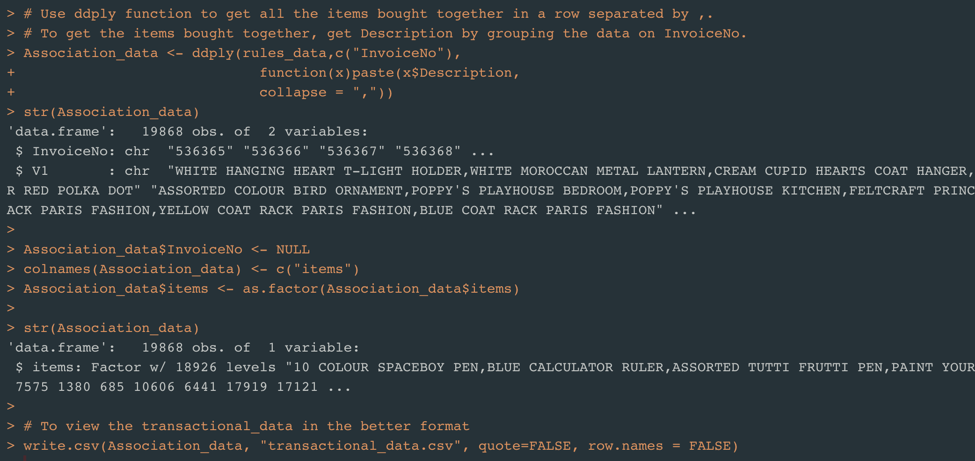
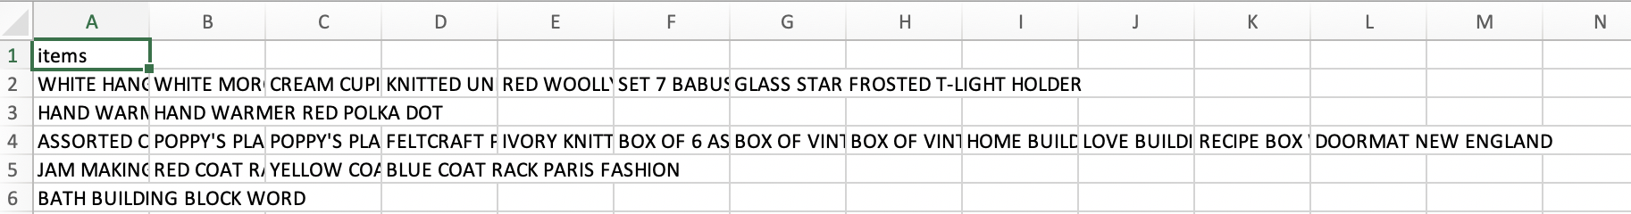
Market Basket Analysis – Format the data

Slide 20
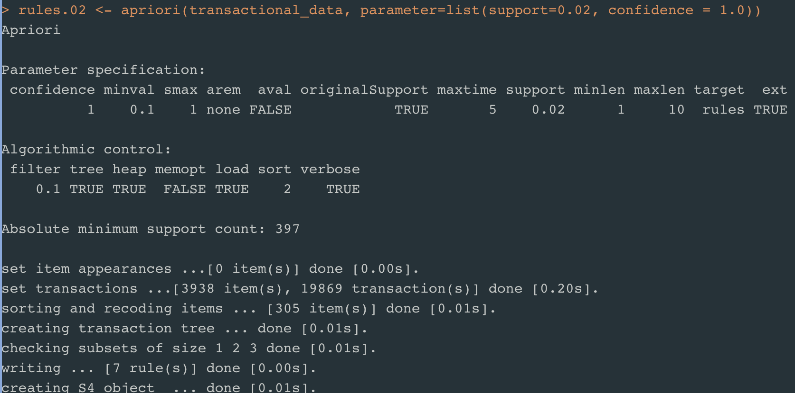
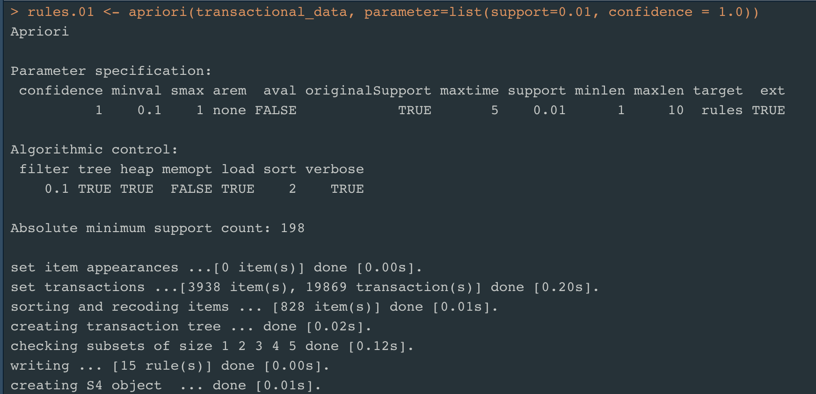
Association Rules – Apriori Algorithm
For Confidence = 1.0 and Support =0.02
- 7 Association Rules
For Confidence = 1.0 and Support =0.02
- 7 Association Rules

Slide 21
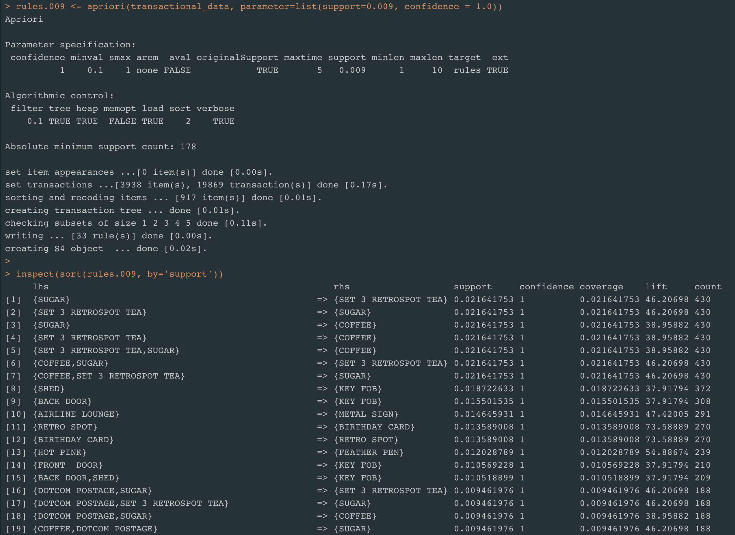
Inspect Association Rules

Slide 22
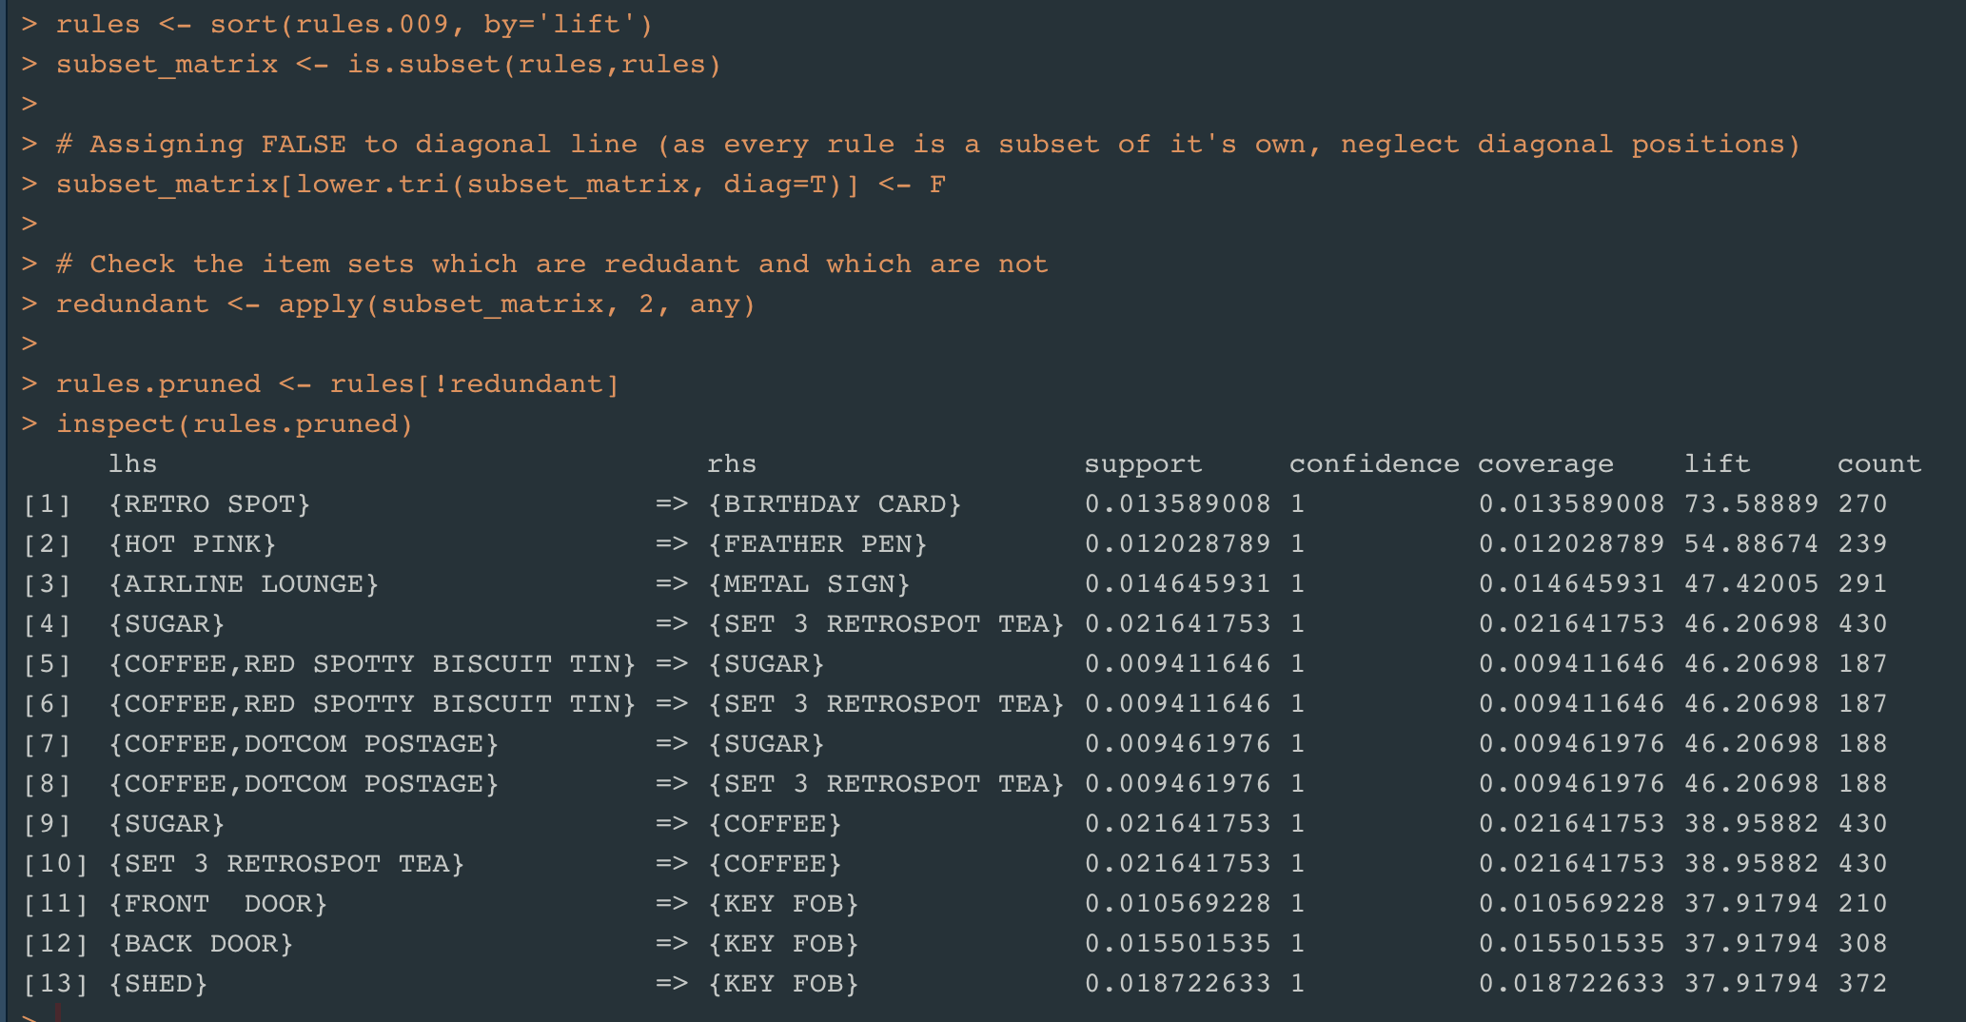
Prune Redundant Association Rules

Slide 23
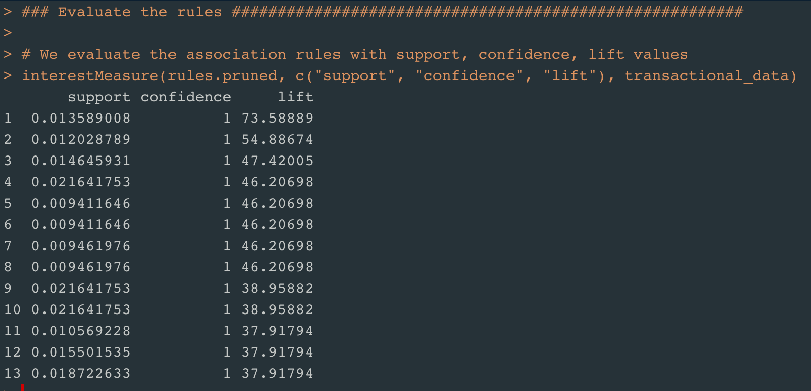
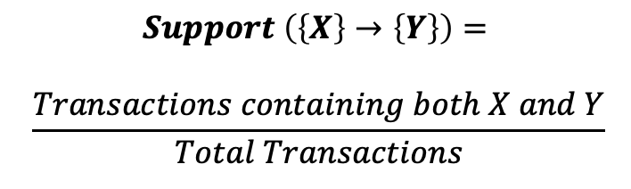
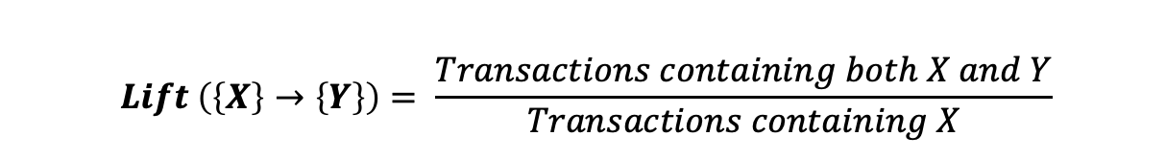
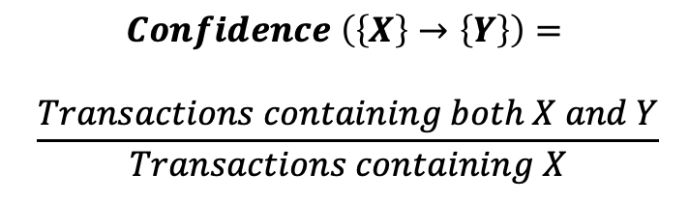
Association rules Evaluation
$$Support \left(\left\{X\right\}→\left\{Y\right\}\right)=$$
$$\frac{Transactions containing both X and Y}{Total Transactions}$$
$$Confidence \left(\left\{X\right\}→\left\{Y\right\}\right)=$$
$$\frac{Transactions containing both X and Y}{Transactions containing X}$$
$$Lift \left(\left\{X\right\}→\left\{Y\right\}\right)= \frac{Transactions containing both X and Y}{Transactions containing X}$$

Slide 24
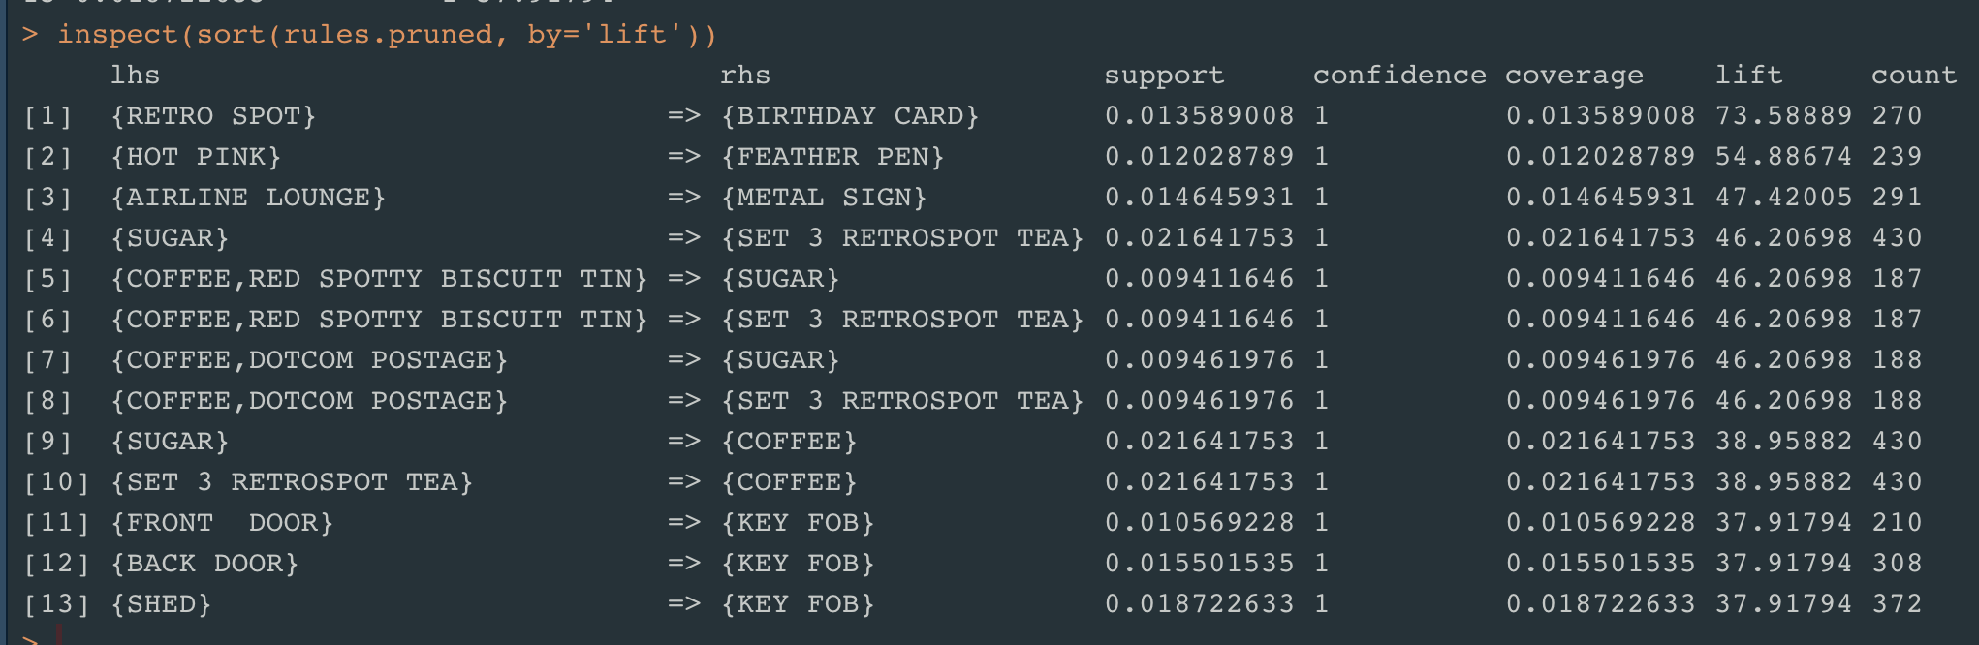
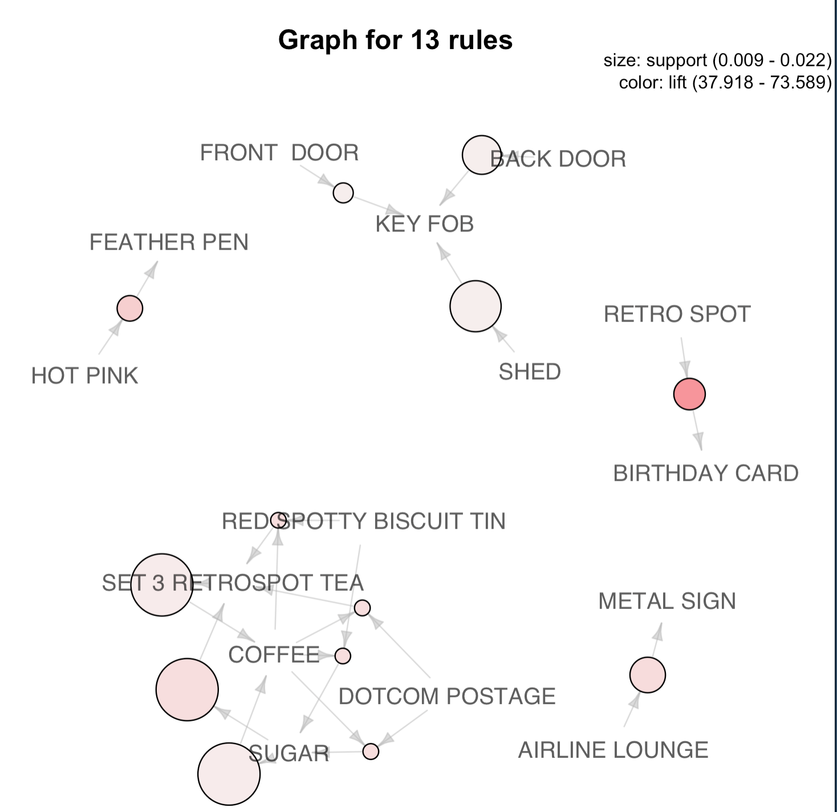
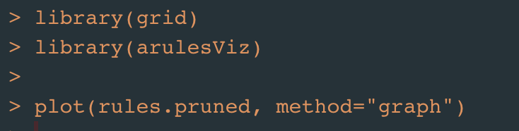
Top 10 Association rules

Slide 26
THANK YOU

